Slide 1

Maple Syrup Urine Disease
(MSUD)
IN THE NAME OF GOD
Supervised by: Dr. Keyfi
Zahra Roshanfekr, Zahra Shahir
1404/09/26
Notes:
62759249-615a-433a-878f-5ccff6d67f3d

Slide 2
Abbreviations
Maple Syrup Urine Disease (MSUD )
Branched Chain a Ketoacid Dehydrogenase (BCKD)
Branched Chain Amino Asids (BCAA)
Notes:
78914ec2-644a-4e26-a9c8-fcba74076f92

Slide 3

OUTLOOK
Definition
The cause of the disease
Pathophysiology
Prevalence and incidence of disease
Types
Symptoms
Diagnosis
Treatment
Complications
Prevention
Prognosis
3
Notes:
72eb133f-e959-4c09-a4cb-c16a5aff074b

Slide 4
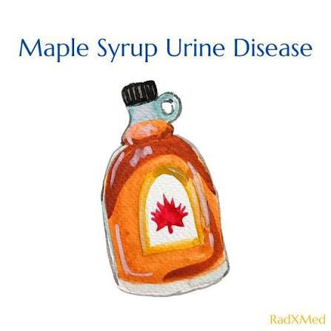
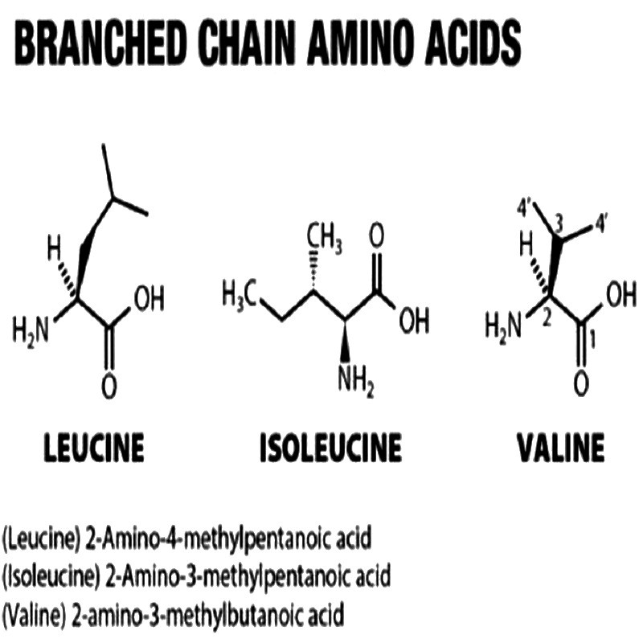
01
Definition
Rare inherited metabolic disorder.
Defect in the breakdown of branched-chain amino acids(BCKD) / leucine, isoleucine, and valine.
Severe neurological manifestations and a characteristic maple syrup–like odor of the urine.
4
Notes:
53ea509b-6c50-4bc6-9755-f76878922f7f

Slide 5
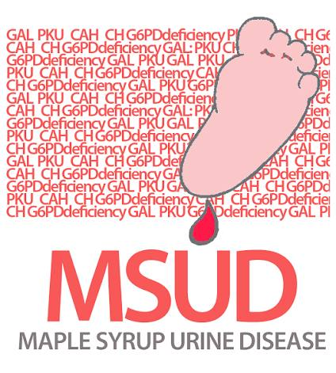
02
cause of the disease
Caused by genetic mutations affecting the genes encoding the BCKD enzyme complex.
Reduced or absent enzymatic activity
Autosomal recessive
5
Notes:
5405b9f5-6dc1-4dc3-8735-abe051f287fc

Slide 6

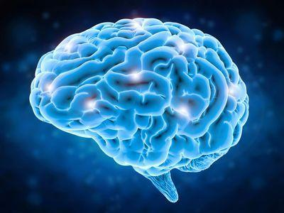
Pathophysiology
03
BCKD enzyme deficiency
Accumulation of amino acids and ketoacid metabolites in the blood and tissues, particularly in the brain
Accumulation of leucine, isoleucine, valine
Toxic effect, especially on the brain
Seizures, lethargy, brain damage
6
Notes:
04e31f47-4772-46db-9e6e-494759801dfe

Slide 7
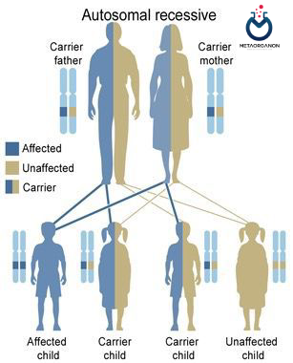
Prevalence and incidence of disease
04
very rare
One in every 185,000 births worldwide
Consanguineous marriage between relatives
7
Notes:
84b1bff3-db27-442b-9b92-e9a043717259

Slide 8
Types of MSUD
05
1
Enzyme Activity: < 2%
1
2
Enzyme Activity: 3 – 30%
Most common type
Symptom Onset: First days of life
Classic MSUD
Control with diet
2
Thiamine-responsive MSUD
Intermediate MSUD
4
Intermttent MSUD
4
Enzyme Activity: < 40%
3
3
Enzyme Activity: 5 to 20%
Rare type
Milder form
8
Notes:
daa6d97b-95f3-47b3-b19a-404ef8145d6a

Slide 9
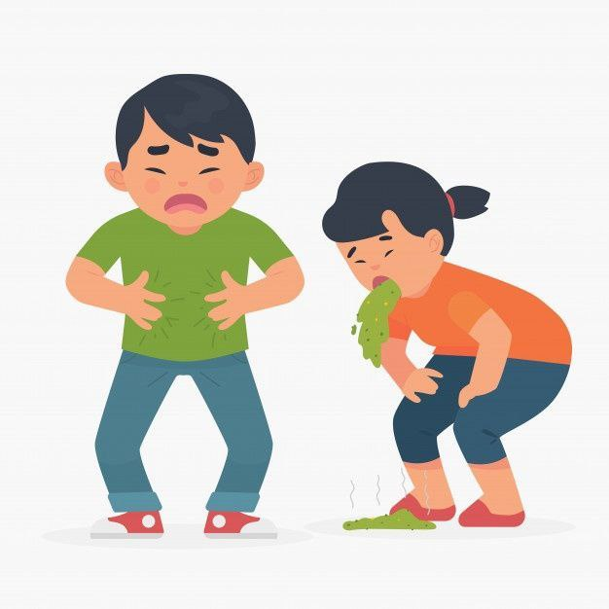

Symptoms
06
Clinical signs
Infant and early:
Loss of appetite, nausea and vomiting, coma
childhood and chronic:
Delays in mental and motor development, speech and learning disorders, behavioral disorders
9
Notes:
eabf6122-4264-4b26-97b8-2e93ad885932

Slide 10
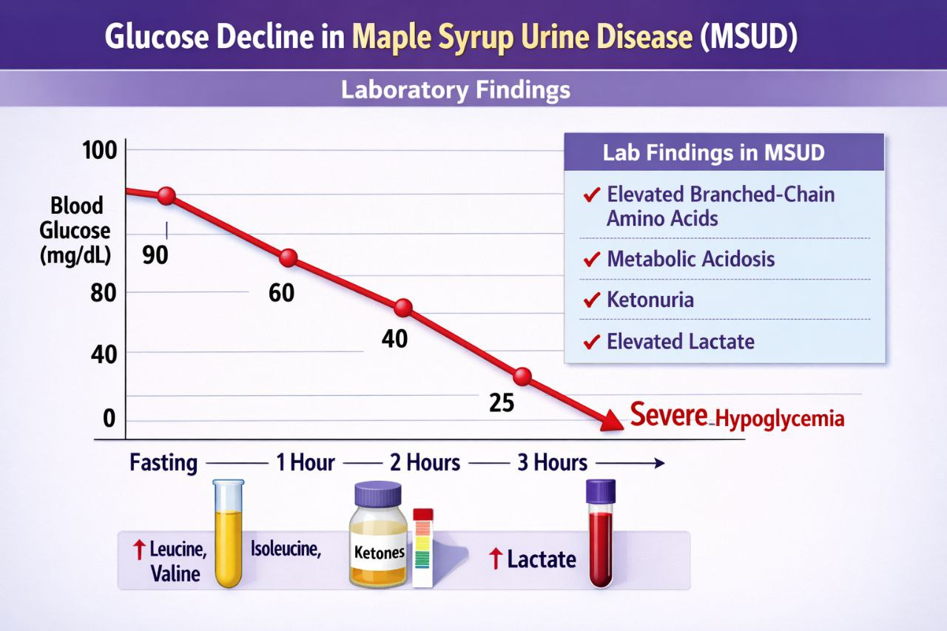
Symptoms
06
Laboratory Findings
Hypoglycemia (low blood sugar)
Elevated branched-chain amino acids in blood: leucine, isoleucine, valine
10
Notes:
eabf6122-4264-4b26-97b8-2e93ad885932

Slide 11
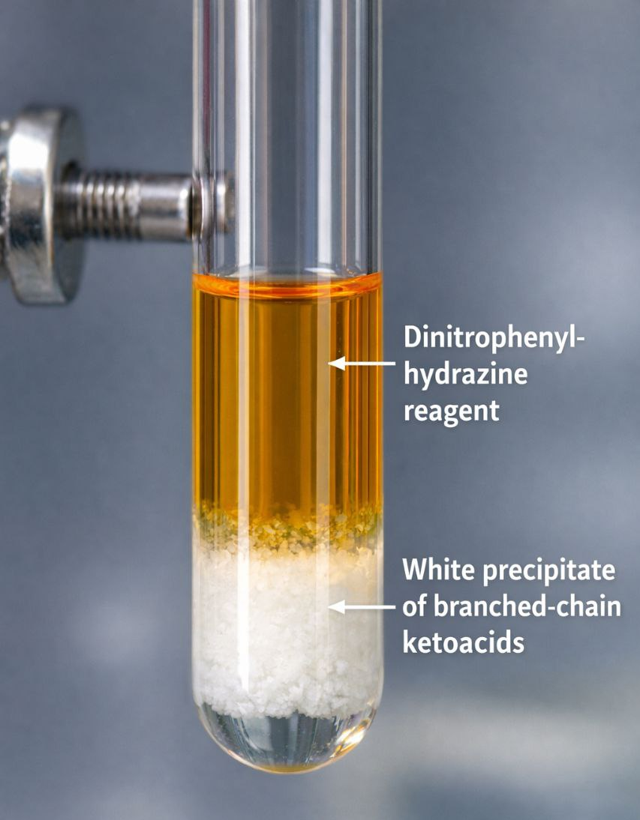
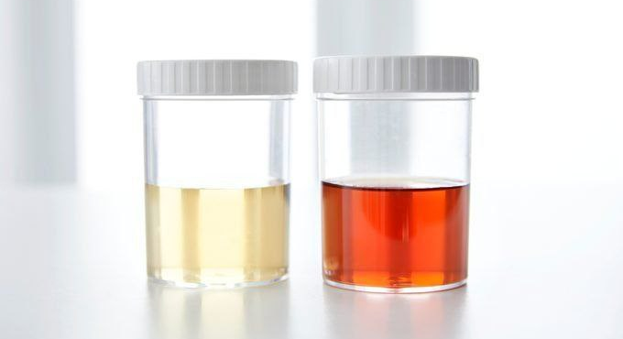
Symptoms
06
Laboratory Findings
Immediate reaction of BCAA ketoacids with dinitrophenylhydrazine → formation of white precipitate
Sweet-smelling urine and dark color
11
Notes:
eabf6122-4264-4b26-97b8-2e93ad885932

Slide 12
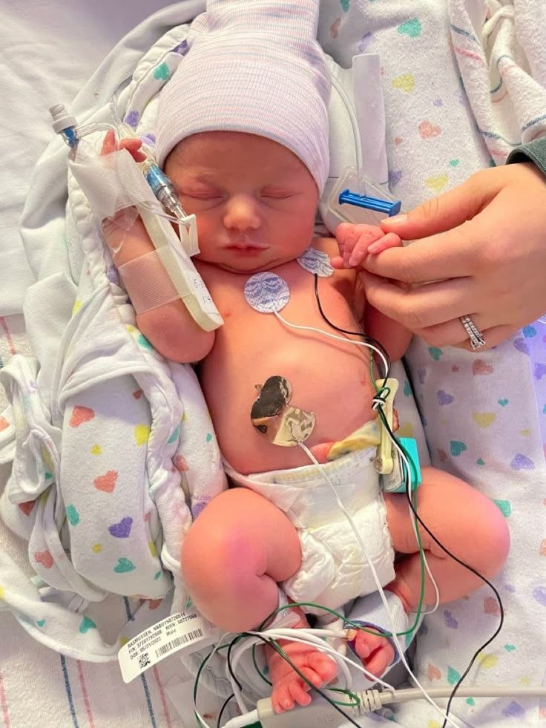
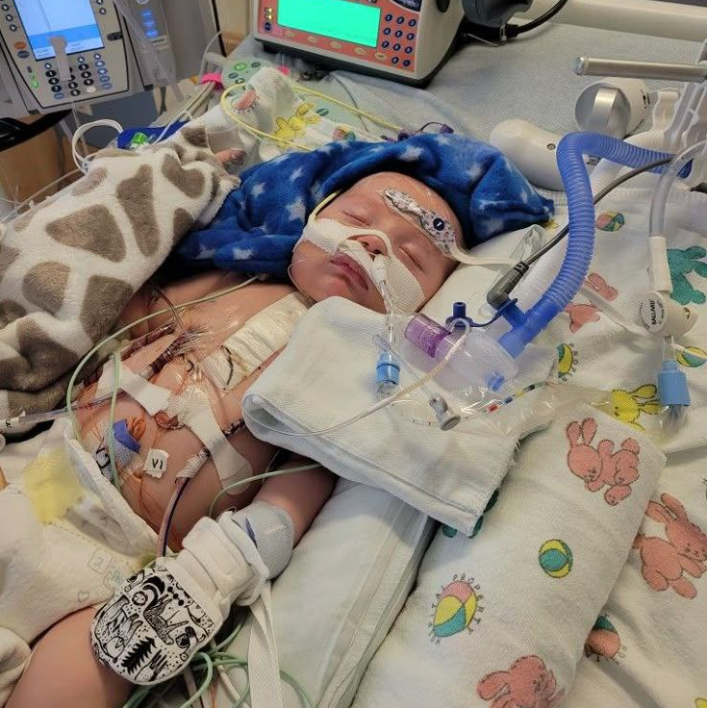
Diagnosis
07
1
Clinical evaluation
lethargic baby
coma
12
Notes:
84b1bff3-db27-442b-9b92-e9a043717259

Slide 13
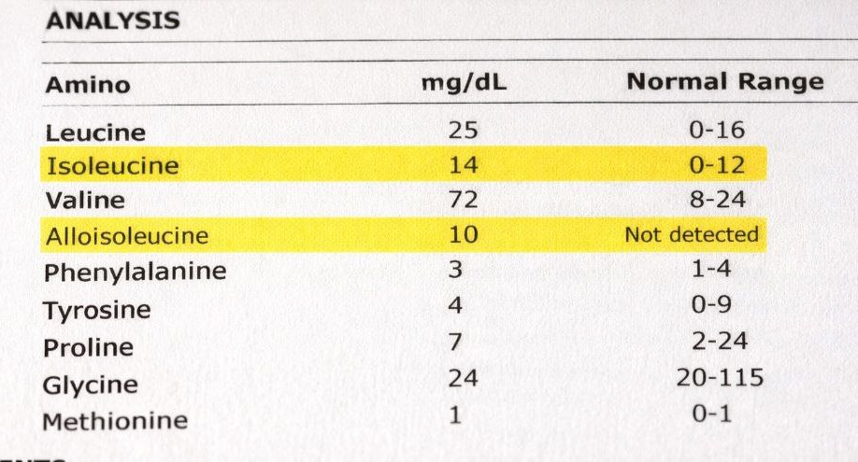
Diagnosis
07
2
Laboratory tests
blood test
13
Notes:
84b1bff3-db27-442b-9b92-e9a043717259

Slide 14
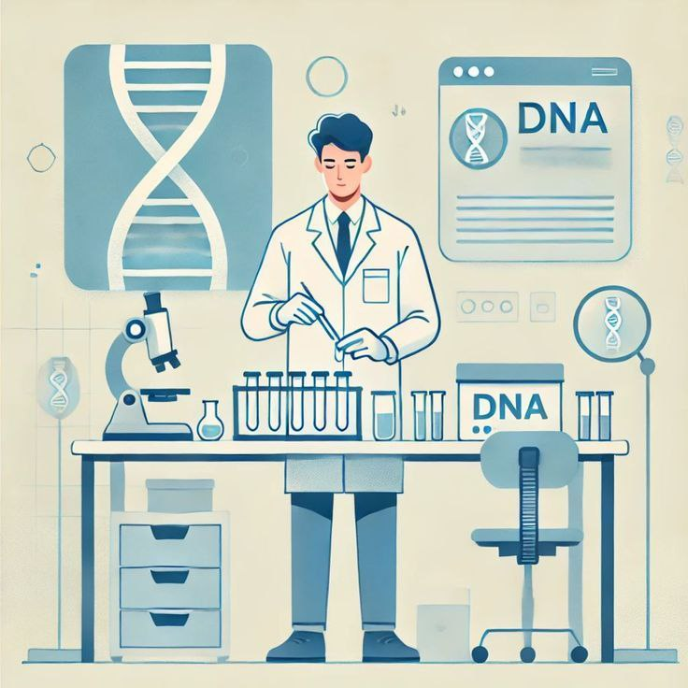
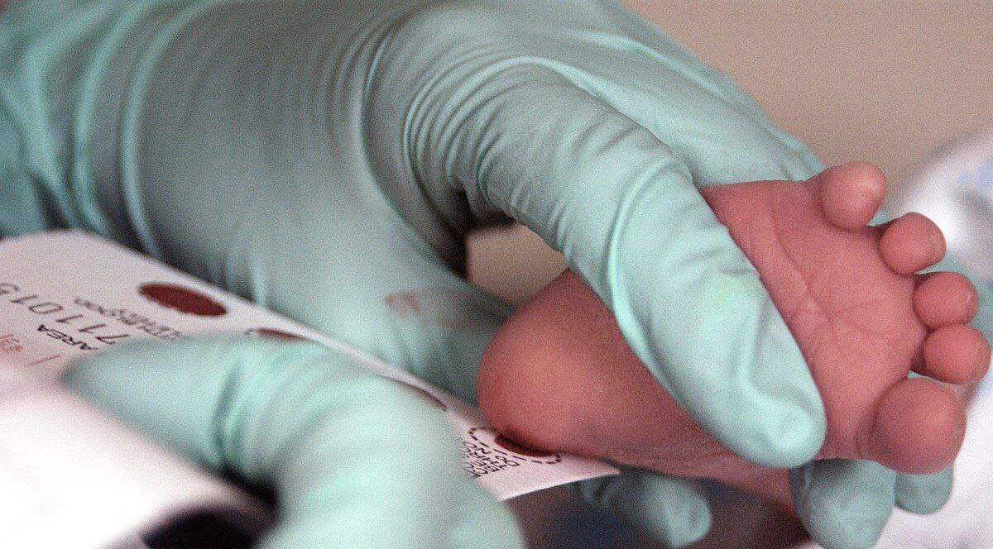
Diagnosis
07
3
Genetic testing
4
Newborn screening
14
Notes:
84b1bff3-db27-442b-9b92-e9a043717259

Slide 15
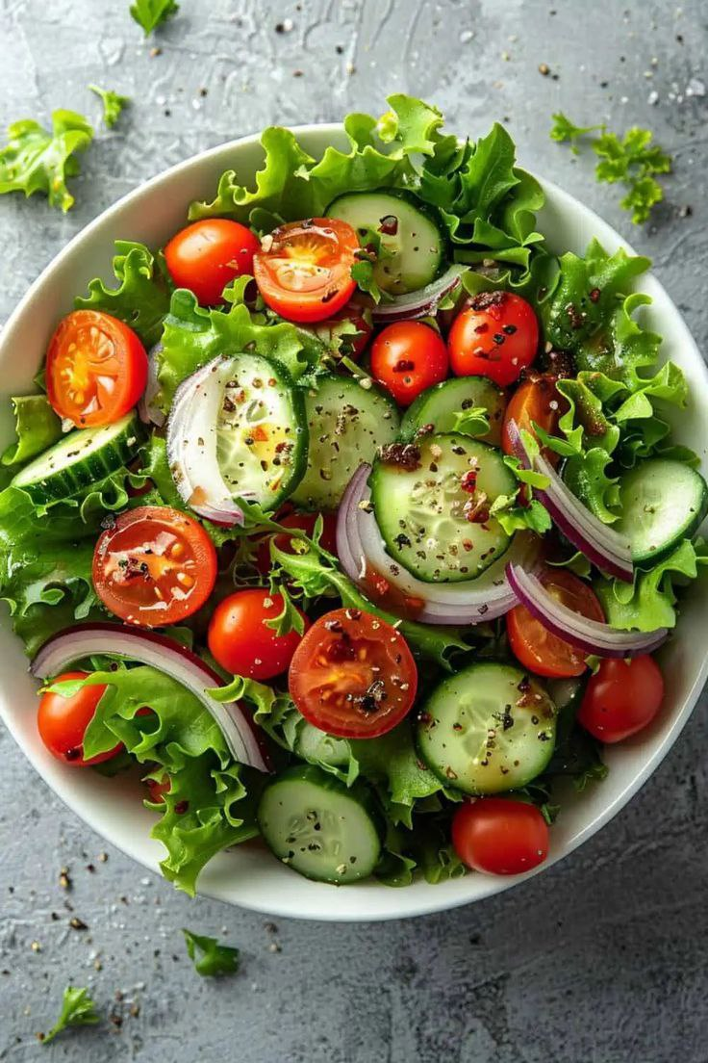
Treatment
08
BCAA-restricted diet
15
Notes:
79cf5743-f99b-460f-b675-301529a9d1f0

Slide 16
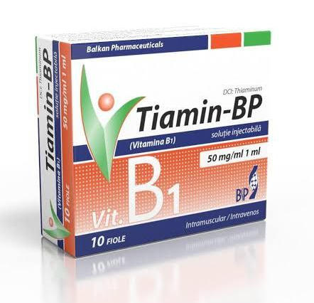
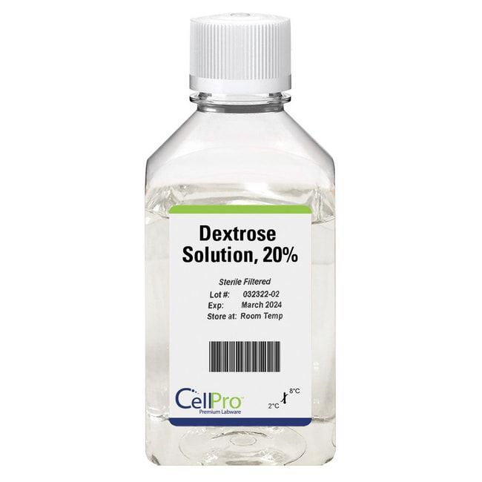
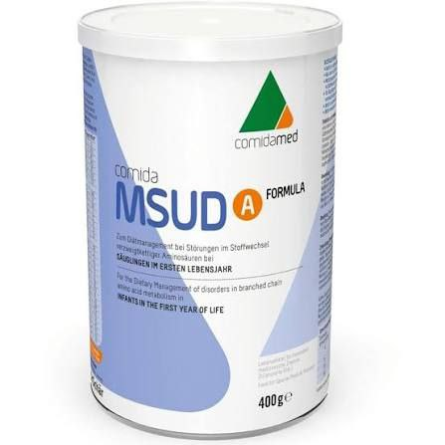
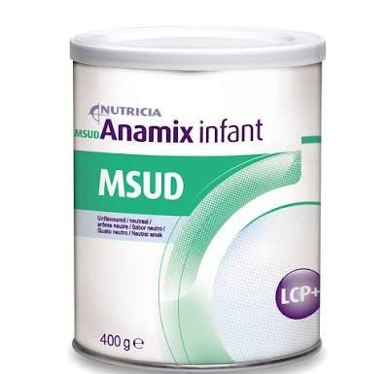
Treatment
08
Medications and supplements
Thiamine
Dextrose solution
MSUD formula
MSUD anamix
16
Notes:
79cf5743-f99b-460f-b675-301529a9d1f0

Slide 17
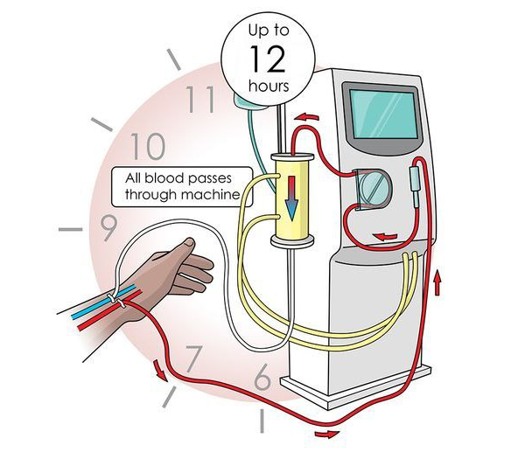
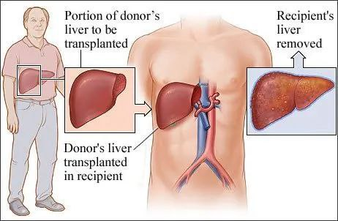
Treatment
08
Dialysis
Liver transplantation
17
Notes:
79cf5743-f99b-460f-b675-301529a9d1f0

Slide 18
Complications
09
Neurological complications
Metabolic complications
Complications
Long-term complications
18
Notes:
55c8939e-6aac-4b74-ac0c-be53ff9e9246

Slide 19
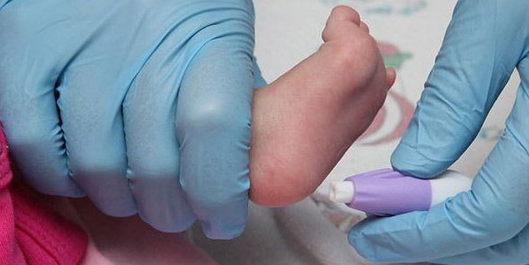


Newborn screening
Prevention
10
Genetic counseling
Controlled diet
19
Notes:
9c39b2b7-48be-4371-a1d8-bb6b5793a745

Slide 20
Disease type matters
Prognosis
11
Early diagnosis
Long-term management
20
Notes:
6b3f9804-a7b2-4385-a9f2-89164ce7f33d

Slide 21
Thanks for your attention.
21
Notes:
07f5b99b-35de-4556-b278-a0c7e1125488

Slide 22
References:
Harper Biochemistry
Children's Diseases by Nelson
Medical Genetics
Robbins' pathology
Google Scholar articles
22

