Slide 1


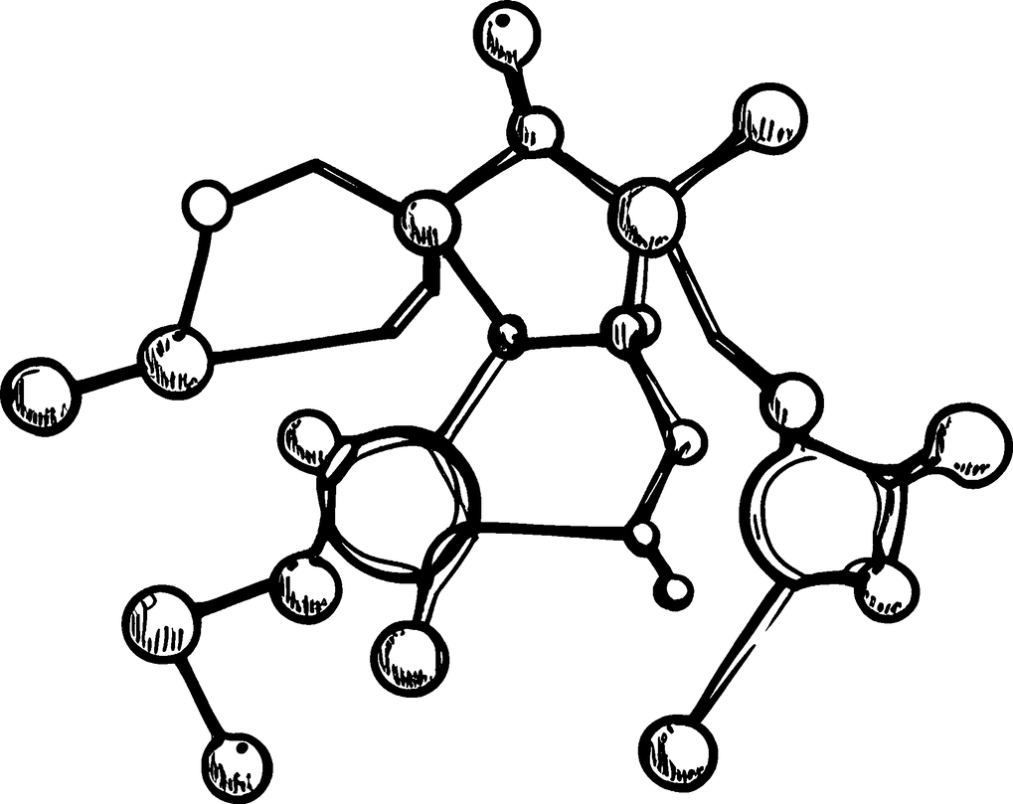
In the name of GOD

Slide 2


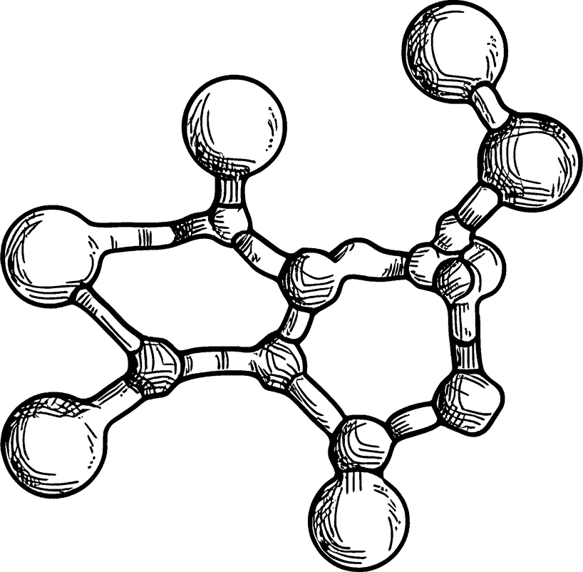
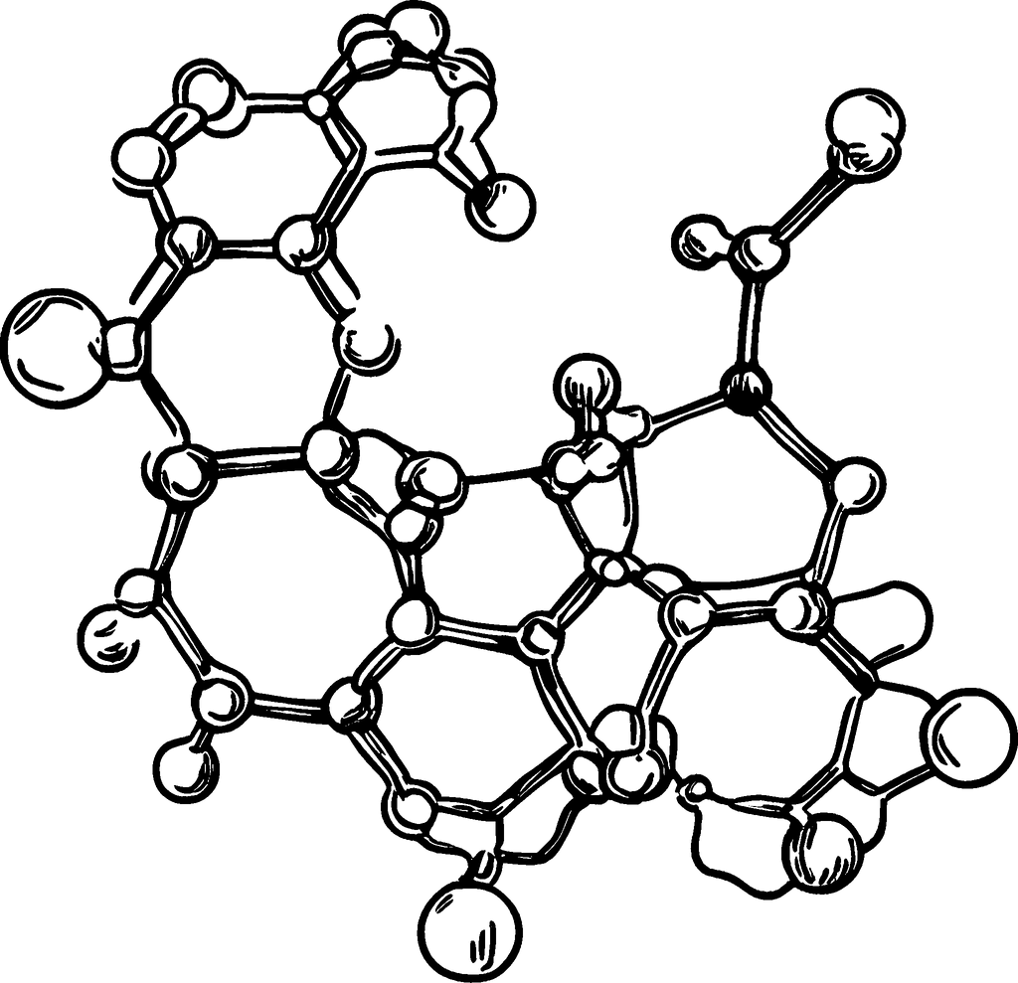
Friedreich's ataxia
Presenters : Salehe Reihani , Sarvenaz zeighami
Professor : Dr. Keyfi

Slide 3

OVERVIEW
01
02
03
04
What Is FA ?
Types of FA
Symptoms
Causes
05
06
07
inheritance
pattern
Diagnosis
Treatment

Slide 4


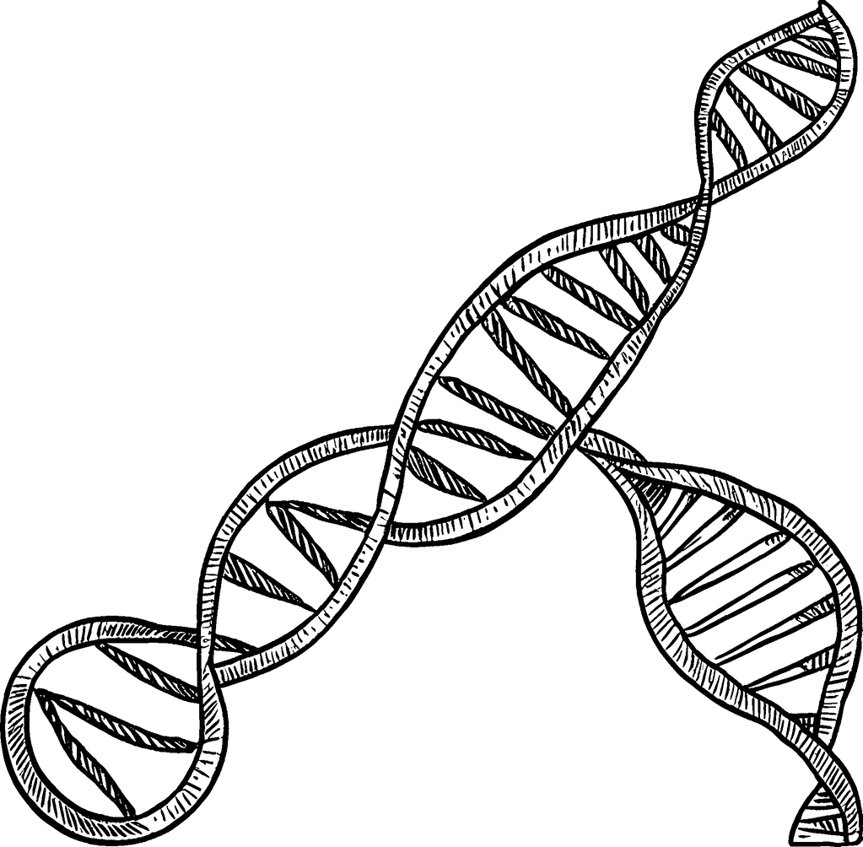
What Is FA ?
Friedreich's ataxia (FA or FRDA) is a rare genetic condition that causes progressive nervous system damage. It may impact your heart function over time. It affects your movement, balance and coordination (ataxia). Symptoms usually start in childhood and get worse.
FA affects approximately 1 in every 50,000 people in the United States. Globally, it affects 1 in every 40,000 people.
4

Slide 5


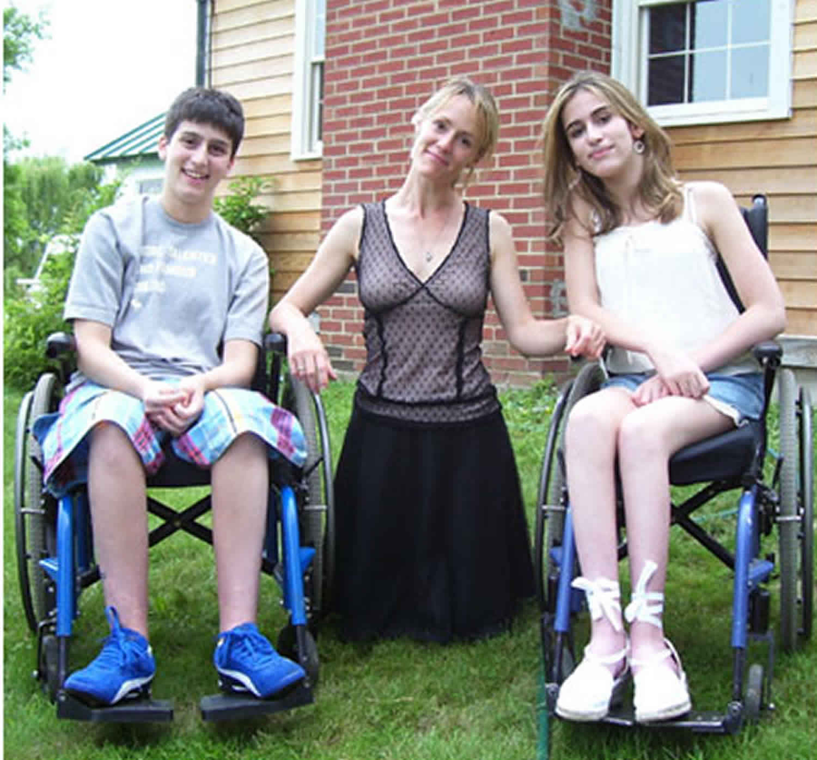

Types of FA
Most cases of FA are known as “typical” when they develop before age 25. There are also two, less common, atypical types:
Late-onset Friedreich’s ataxia (LOFA): You develop symptoms after 25
Very late-onset Friedreich’s ataxia (VLOFA): Signs and symptoms start after 40
LOFA and VLOFA usually progress more slowly than typical FA.
5

Slide 6




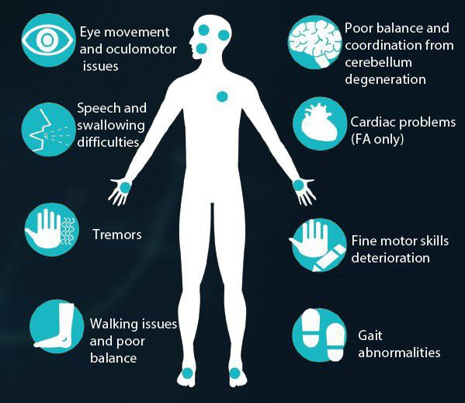
Symptoms
6

Slide 7
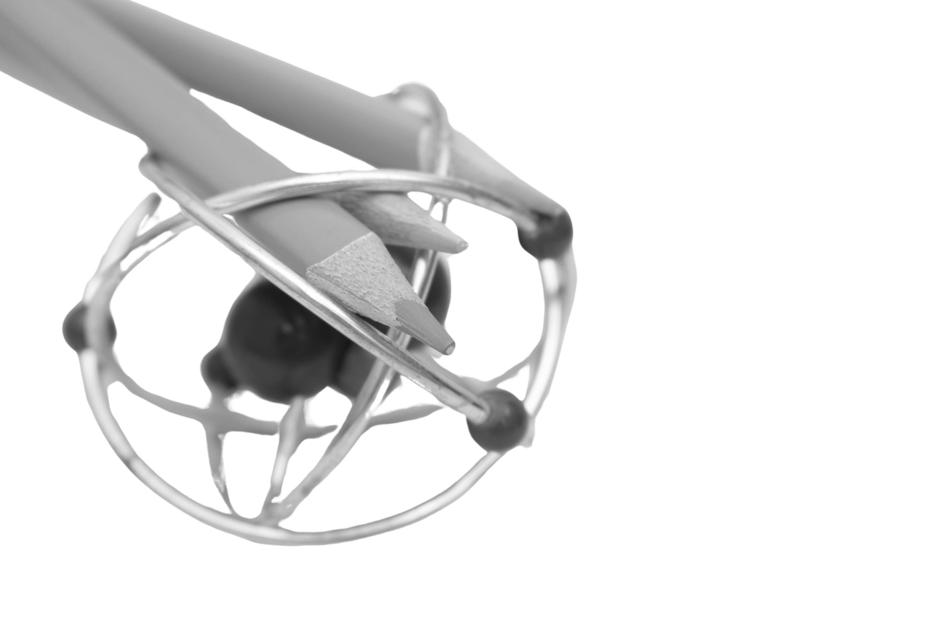
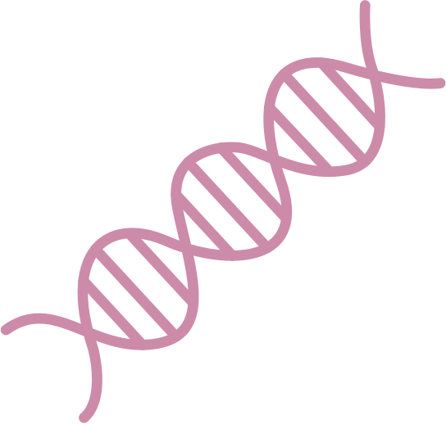
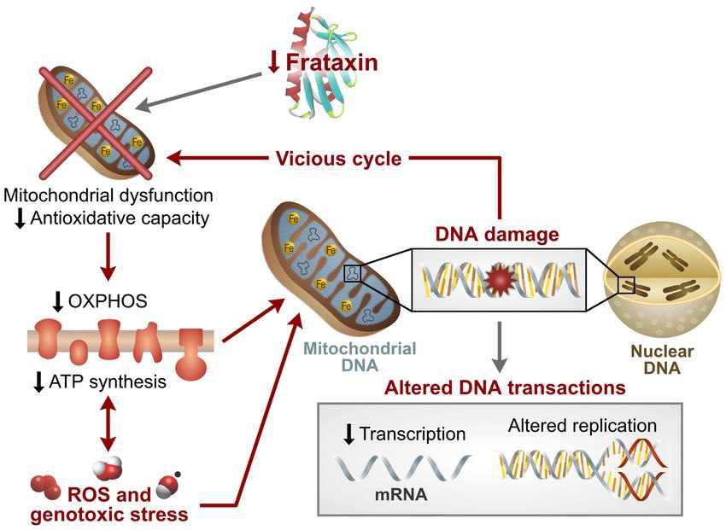
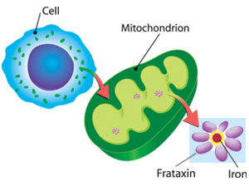
Causes
7

Slide 8
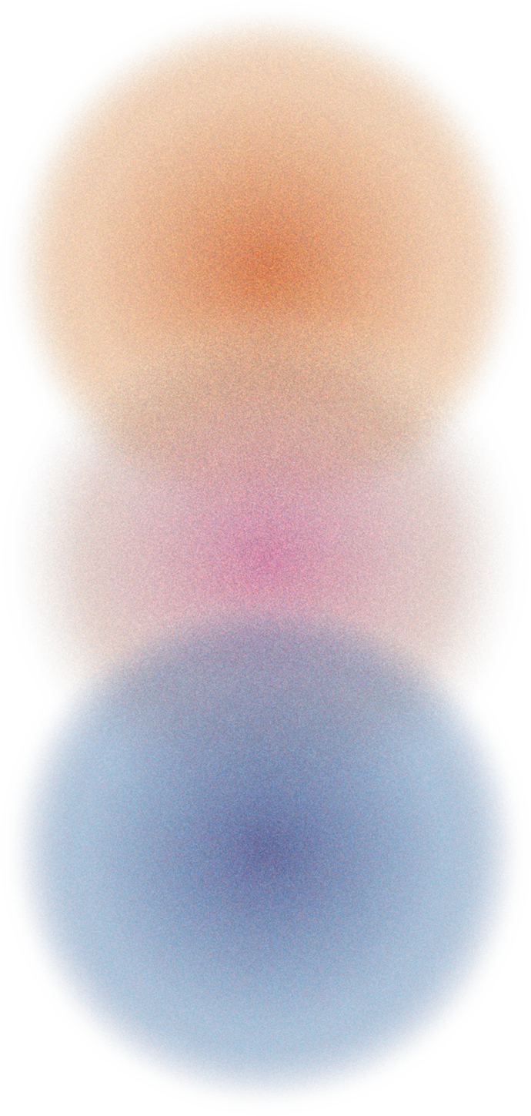

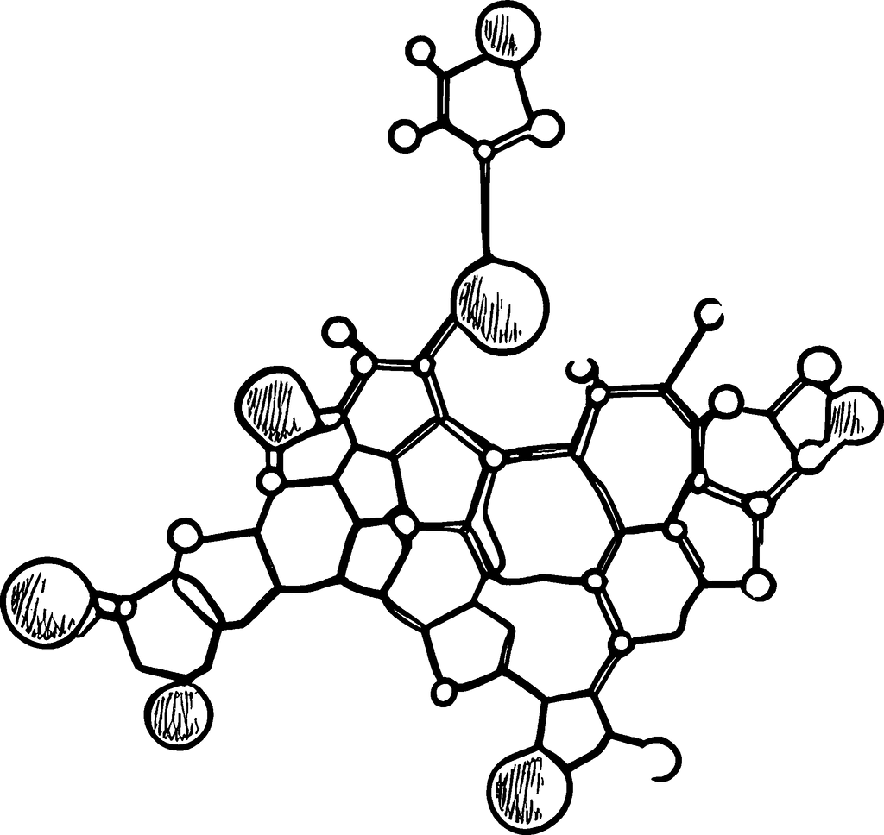
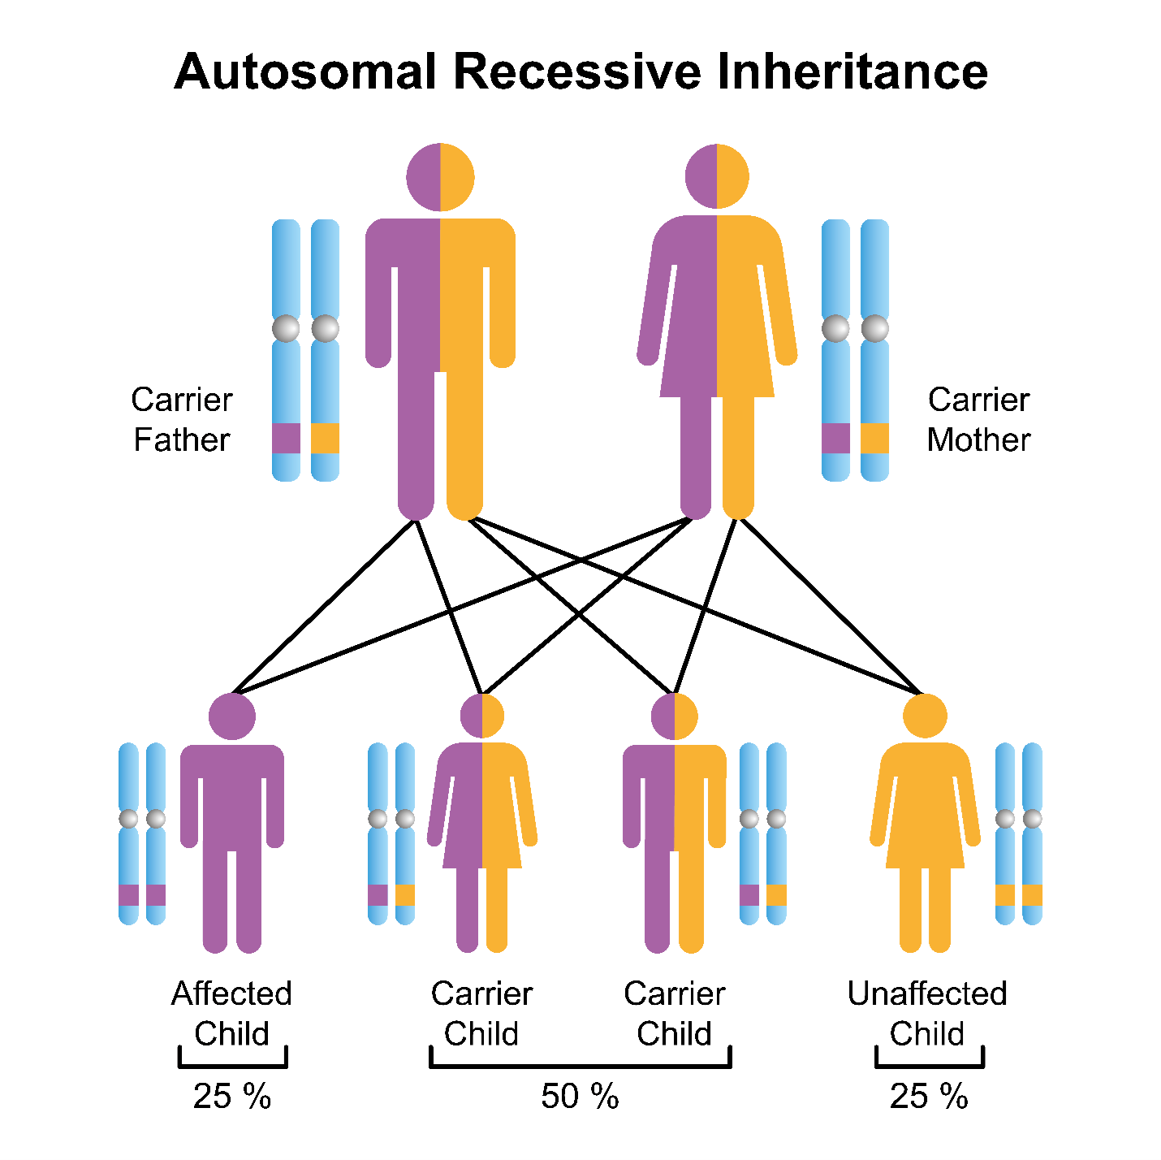
Inheritance pattern
8

Slide 9

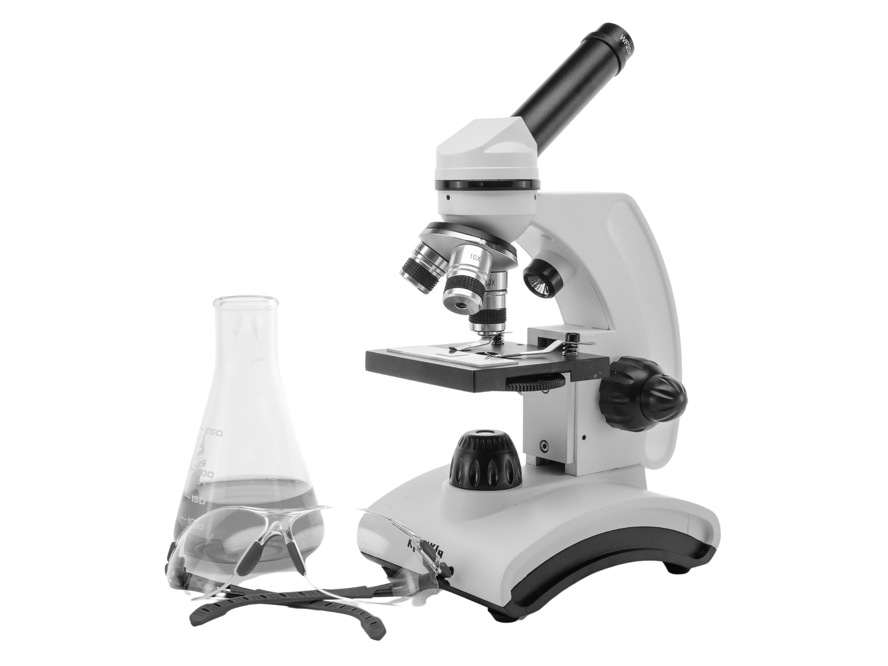

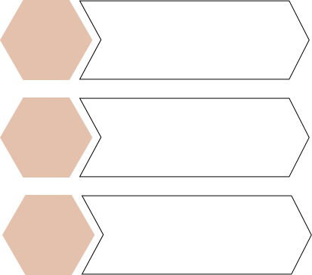
Diagnosis
1
2
MRI
Echocardiogram
3
4
CT Scan
Electrocardiogram
(ECG/EKG)
5
EMG
(Electromyography)
6
Blood Tests
9

Slide 10


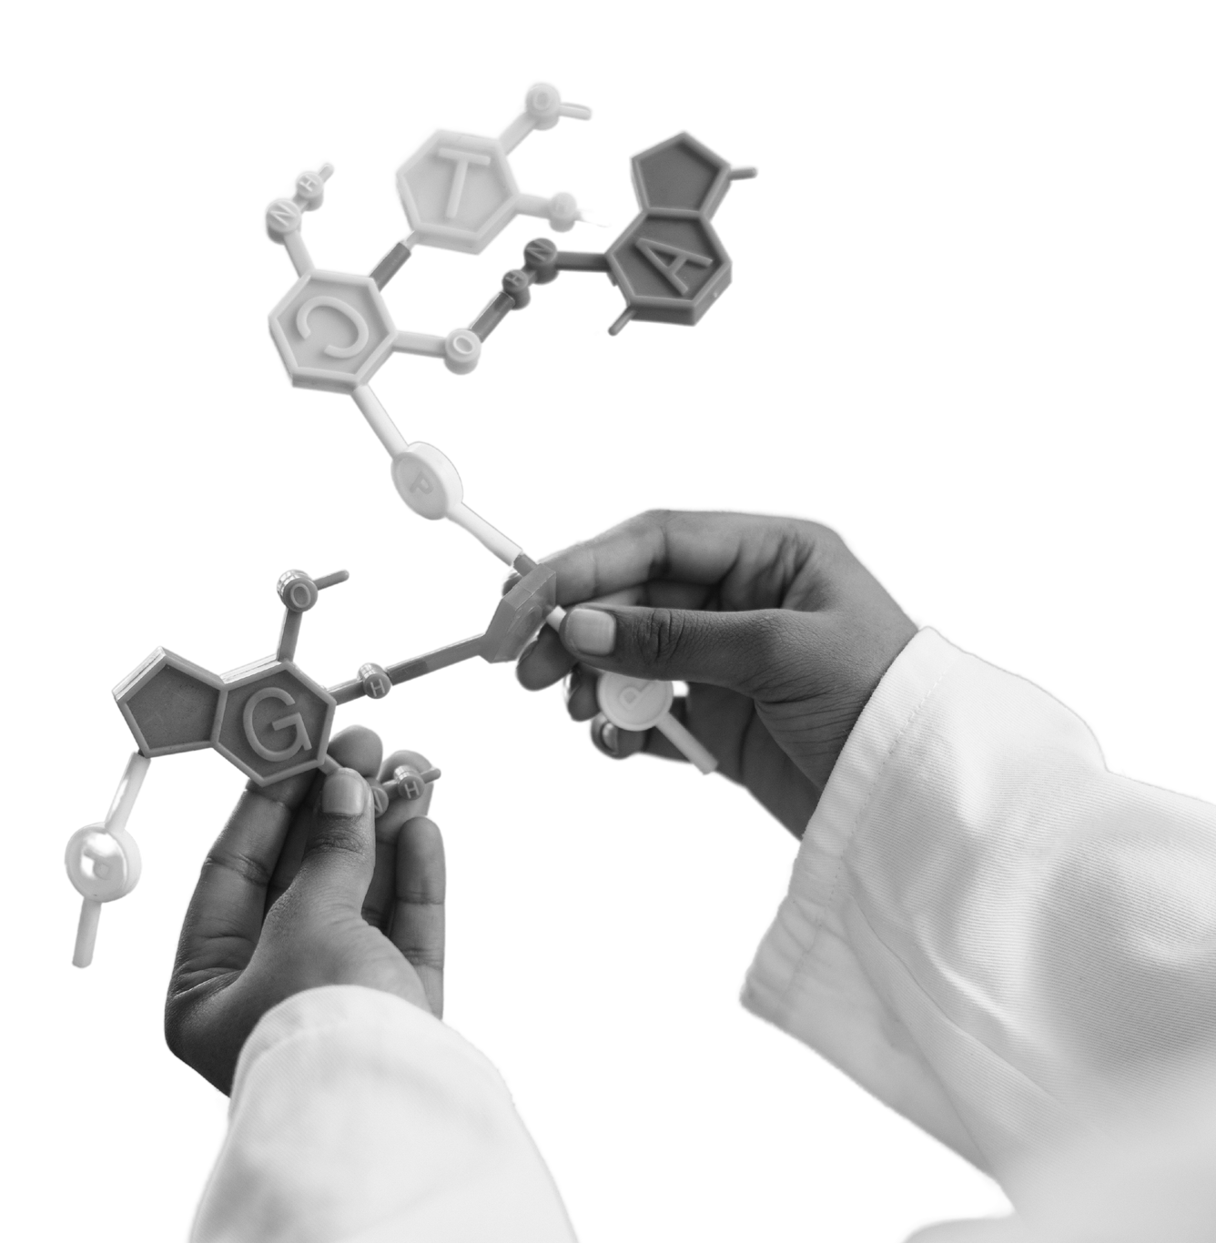
Treatment
The main goal of treatment is to manage symptoms and complications. This helps your body work as well as possible for as long as possible. Treatment may include:
Physical therapy to help with muscle strength, balance and coordination
Speech therapy to improve speech and swallowing
Braces or surgery to treat foot problems or scoliosis
Medicine for heart conditions, if needed
Medicine for diabetes, if needed
Therapies to manage pain
Antibiotics to treat or prevent infections
Mobility aids like special shoes, canes or wheelchairs
Heart transplant for serious heart complications
10

Slide 11
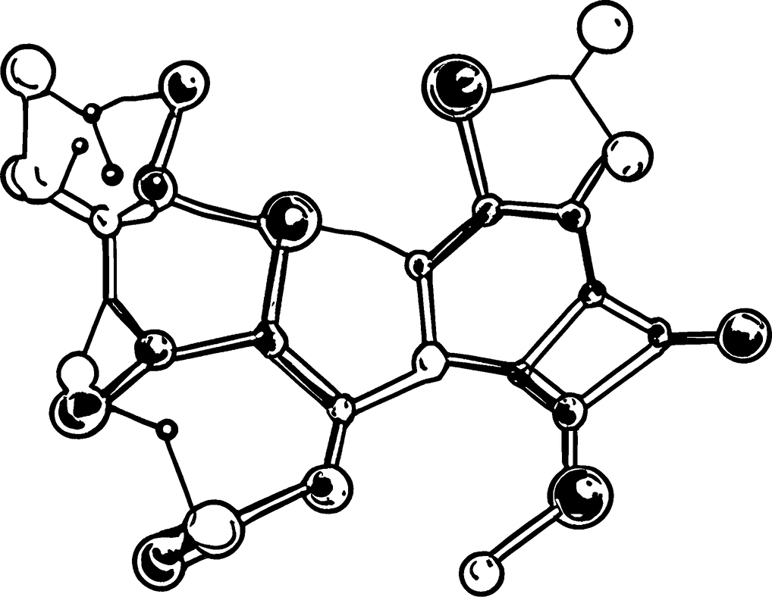
Reference
1. Corben LA, Collins V, Milne S, Farmer J, Musheno A, Lynch D, Subramony S, Pandolfo M, Schulz JB, Lin K, Delatycki MB; Clinical Management Guidelines Writing Group. Clinical management guidelines for Friedreich ataxia: best practice in rare diseases. Orphanet J Rare Dis. 2022;17:415
2. NCBI Genes and Disease
3. https://www.ncbi.nlm.nih.gov/books/NBK1281/
4.https://www.ninds.nih.gov/health-information /disorders/friedreich-ataxia
11

Slide 12
Thank you for your attention

