Slide 1

Measuring vitamin D in the body
Under advice of Dr.Keify
Melika Hosseinpour / Arezoo Ezanlo

Slide 2

What is vitamin D and why is it important
Vitamin D is a fat-soluble vitamin that also acts as a prohormone. It plays vital roles in mental health, immune system regulation, cardiovascular health, calcium and phosphorus metabolism, and bone maintenance. Deficiency can lead to conditions like rickets in children and osteomalacia in adults.

Slide 3

Sources of Vitamin D
Sunlight:
UVB exposure triggers the conversion of 7-dehydrocholesterol in the skin to vitamin D3 (cholecalciferol). Factors like exposure time, skin color, and season affect synthesis.
Dietary Sources:
Fatty fish (salmon, sardines, tuna)Egg yolk Beef liver UV-exposed mushrooms Fortified foods (milk, breakfast cereals, orange juice)
Supplements:
Prescribed when deficiency is present .Vitamin D3 (cholecalciferol): from animal sources Vitamin D2 (ergocalciferol): from plant sources

Slide 4
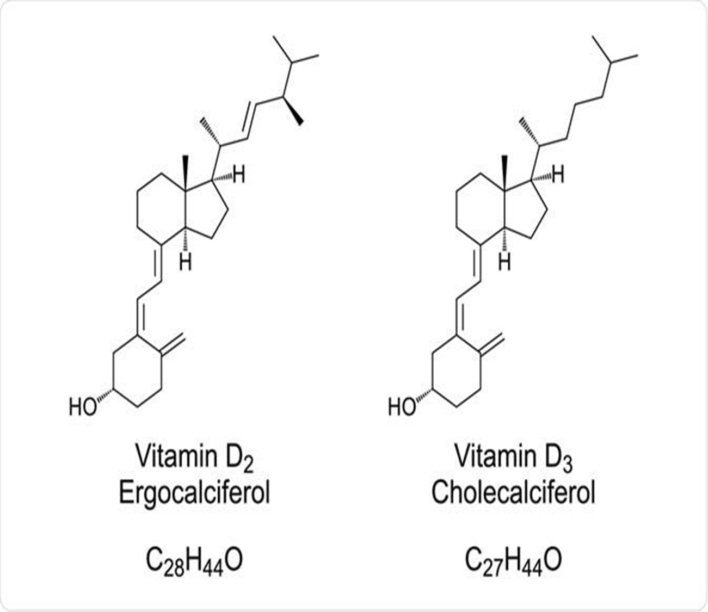
Biochemistry of Vitamin D: Synthesis and Regulation
1. Chemical Structure Vitamin D3 is a secosteroid derived from 7-dehydrocholesterol in the skin . Vitamin D2 is produced from ergosterol in plants and fungi under UVB light.

Slide 5
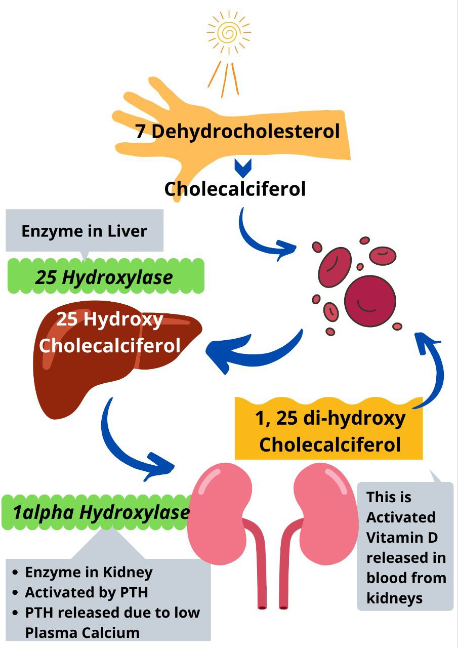
Biochemistry of Vitamin D: Synthesis and Regulation
2. Synthesis and Activation Pathway
A. Skin Synthesis :
UVB (280–320 nm) converts 7-dehydrocholesterol into pre-vitamin D3 → then into vitamin D3 (cholecalciferol) through thermal isomerization.
B. Kidney Activation:
25(OH)D is hydroxylated by 1α-hydroxylase (CYP27B1) → becomes 1,25(OH)₂D (calcitriol), the biologically active form

Slide 6
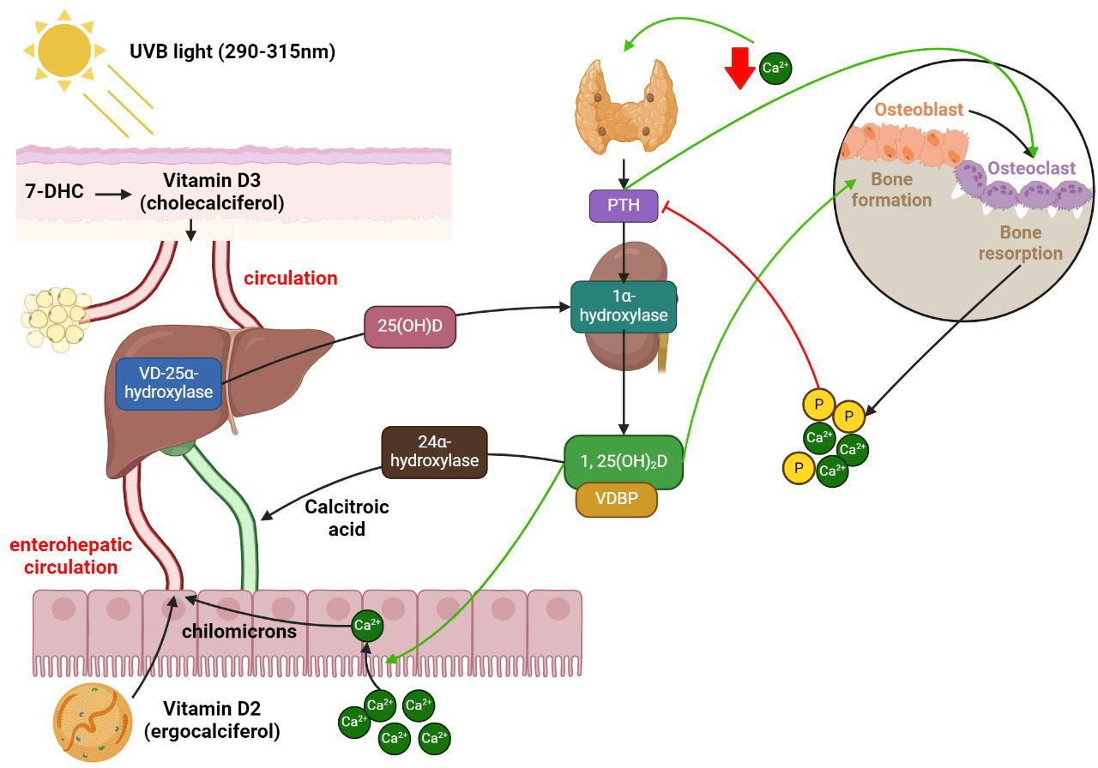
.C. Liver Conversion:
Vitamin D3 is hydroxylated by 25-hydroxylase (CYP2R1) → becomes 25(OH)D (calcidiol), the main circulating form.

Slide 7
Key Enzymes in Vitamin D Metabolism
CYP2R1 (25-hydroxylase)
Site: Liver
Role: Converts D3 to 25(OH)D
Regulation: Reduced in obesity, diabetes, corticosteroid use
CYP27B1 (1α-hydroxylase)
Site: Kidney (and others: immune cells, bone)
Role: Converts calcidiol to calcitriol
Regulation: Stimulated by PTH; inhibited by FGF23, high phosphate
CYP24A1 (24-hydroxylase)
Site: Kidney, other tissues
Role: Inactivates calcitriol by converting it to 24,25(OH)₂D or calcitroic acid

Slide 8
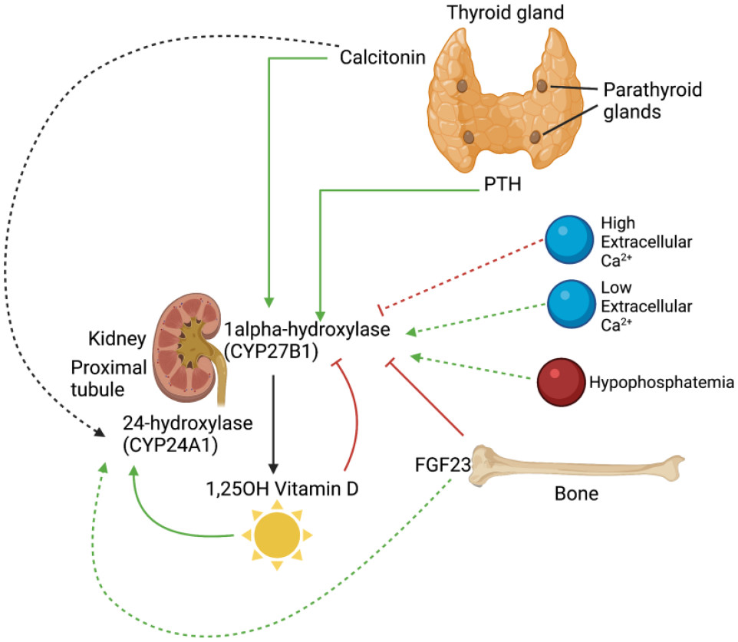
🧬 Hormonal Regulation
Parathyroid hormone (PTH):
Increases CYP27B1 activity → raises calcitriol levels
FGF23:
Inhibits CYP27B1 → lowers calcitriol
Calcium & phosphate levels:
Low levels stimulate calcitriol production

Slide 9
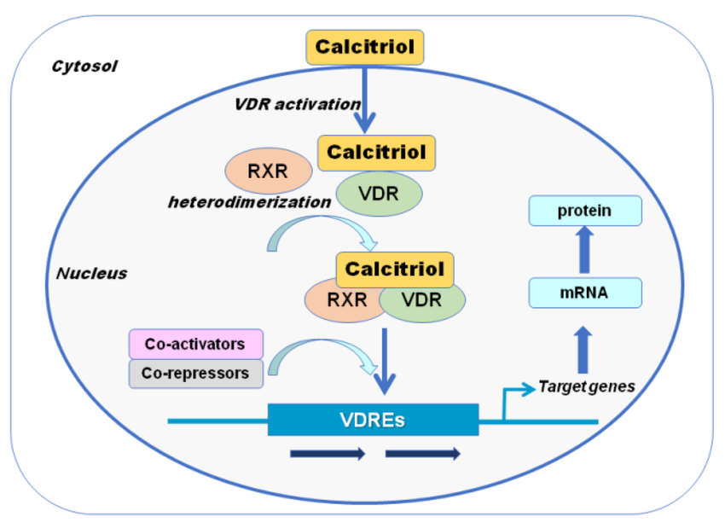
Biological Role of Calcitriol
Vitamin D Receptor (VDR):
Calcitriol binds VDR, forms a complex with DNA, and regulates gene expression.
Gene Regulation:
Affects genes involved in calcium absorption (intestine), calcium reabsorption (kidney), and immune/bone cell differentiation.

Slide 10
⚠️Disorders Related to Vitamin D
Deficiency:
Symptoms: fatigue, bone pain, muscle weakness, depression, infections
Diseases: rickets, osteomalacia, osteoporosis, autoimmune diseases
Toxicity:
Symptoms: hypercalcemia, nausea, vomiting, weakness, kidney damage
Cause: excessive supplement use

Slide 11
🧠Vitamin D in Mental Health and Aging
Recent studies suggest vitamin D slows aging by preventing telomere shortening. It may reduce risks of chronic diseases like Alzheimer’s, cancer, and cardiovascular disease

Slide 12
Types of Vitamin D Tests
25(OH)D (Calcifediol): Most accurate and commonly used.
1,25(OH)₂D (Calcitriol): Active form, but less reliable for status assessment

Slide 13
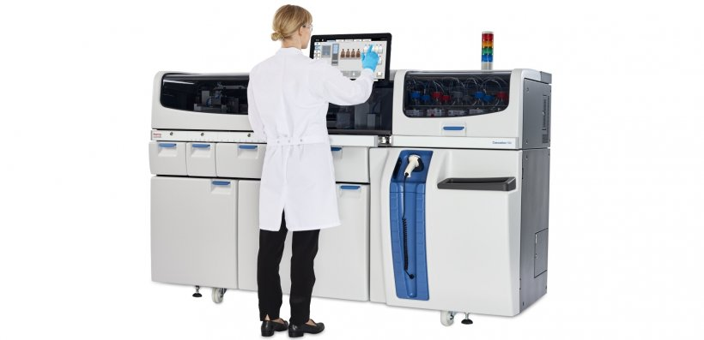
Laboratory Methods
Immunoassays: ELISA, CLIA, RIA – Fast, cost-effective.
LC-MS/MS: Gold standard – High precision and specificity.

Slide 14
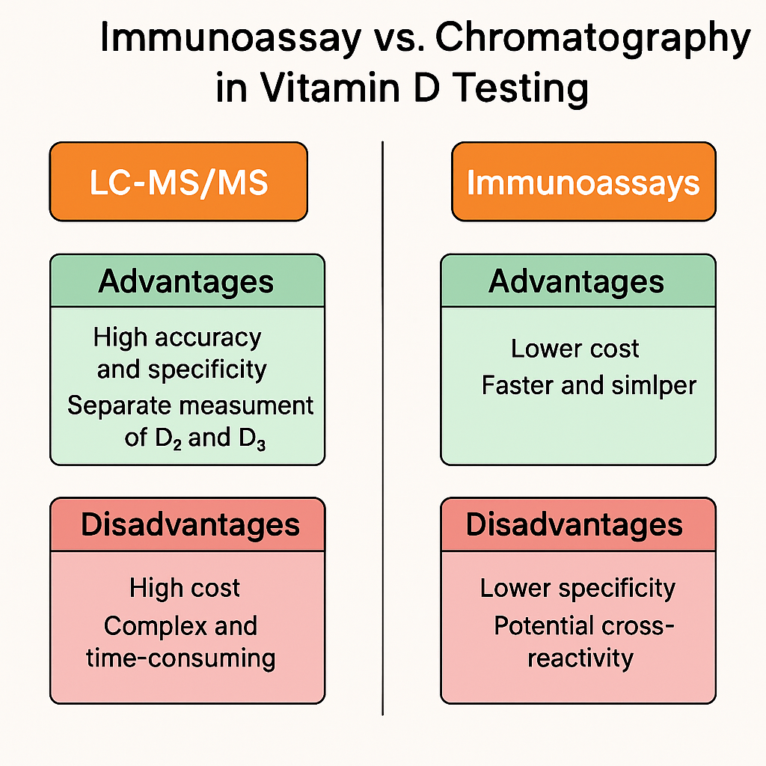

Slide 15
Interpretation of Test Results
• Normal: 20–50 ng/mL
• Deficiency: <20 ng/mL
• Toxicity: >150 ng/mL
Factors: age, season, obesity, kidney/liver disease

Slide 16
References
https://pubmed.ncbi.nlm.nih.gov/38836946/
https://www.mdpi.com/2072-6643/10/4/482
https://pmc.ncbi.nlm.nih.gov/articles/PMC3968073/
Portale AA, Miller WL. Human 25-hydroxyvitamin D-1alpha-hydroxylase: cloning, mutations, and gene expression. Pediatr Nephrol. 2000 Jul;14(7):620-5. doi: 10.1007/pl00009639. PMID: 10912530.
https://ods.od.nih.gov/factsheets/VitaminD-HealthProfessional/?utm_

Slide 17
Thank you for your attention .

