Slide 1

CRISPR-Cas9: Precision Gene Editing Technology
Presented by: Sahel Komeili & Bahareh Charbgu professor : Dr. Keyfi

Slide 2
Introduction to CRISPR-Cas9
Derived from bacterial immune system
Advanced genome editing technology
CRISPR = Clustered Regularly Interspaced Short Palindromic Repeats
Cas9 = DNA cutting enzyme

Slide 3
Origin of CRISPR System
Derived from bacterial immune system
First observed in 1987
Used against bacteriophage infections

Slide 4
CRISPR Components
CRISPR Array (memory of past infections)
tracrRNA (trans-activating RNA)
Cas9 protein (endonuclease enzyme
How CRISPR Works
Guide RNA binds to target DNA
Cas9 makes double-strand break
Cell repairs the break (NHEJ or HDR)

Slide 5
Guide RNA Design
Cas9 Enzyme Function
20-nucleotide sequence
Matches target DNA
Requires PAM (Protospacer Adjacent Motif)
Makes precise DNA cuts
Has two nuclease domains: RuvC & HNH
Introduces double-stranded breaks

Slide 6
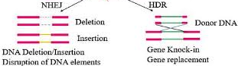
Repair Mechanisms
NHEJ: causes gene disruption
HDR: allows precise insertion/replacement

Slide 7
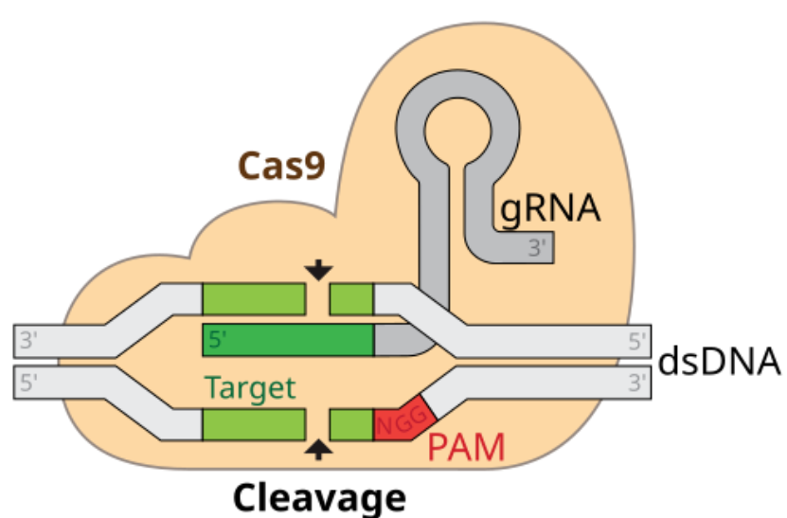

Slide 8
Applications in Medicine
Gene therapy (e.g., sickle cell, thalassemia)
Cancer immunotherapy
Viral infection resistance (e.g., HIV)

Slide 9
Ethical Concerns
Germline editing risks
Designer babies controversy
Regulatory gaps

Slide 10
Off-target Effects
Unintended DNA cuts
Genome instability risks
Need for high specificity

Slide 11
Thanks for your attention

