Slide 1
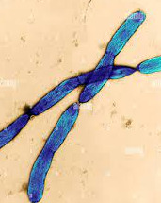
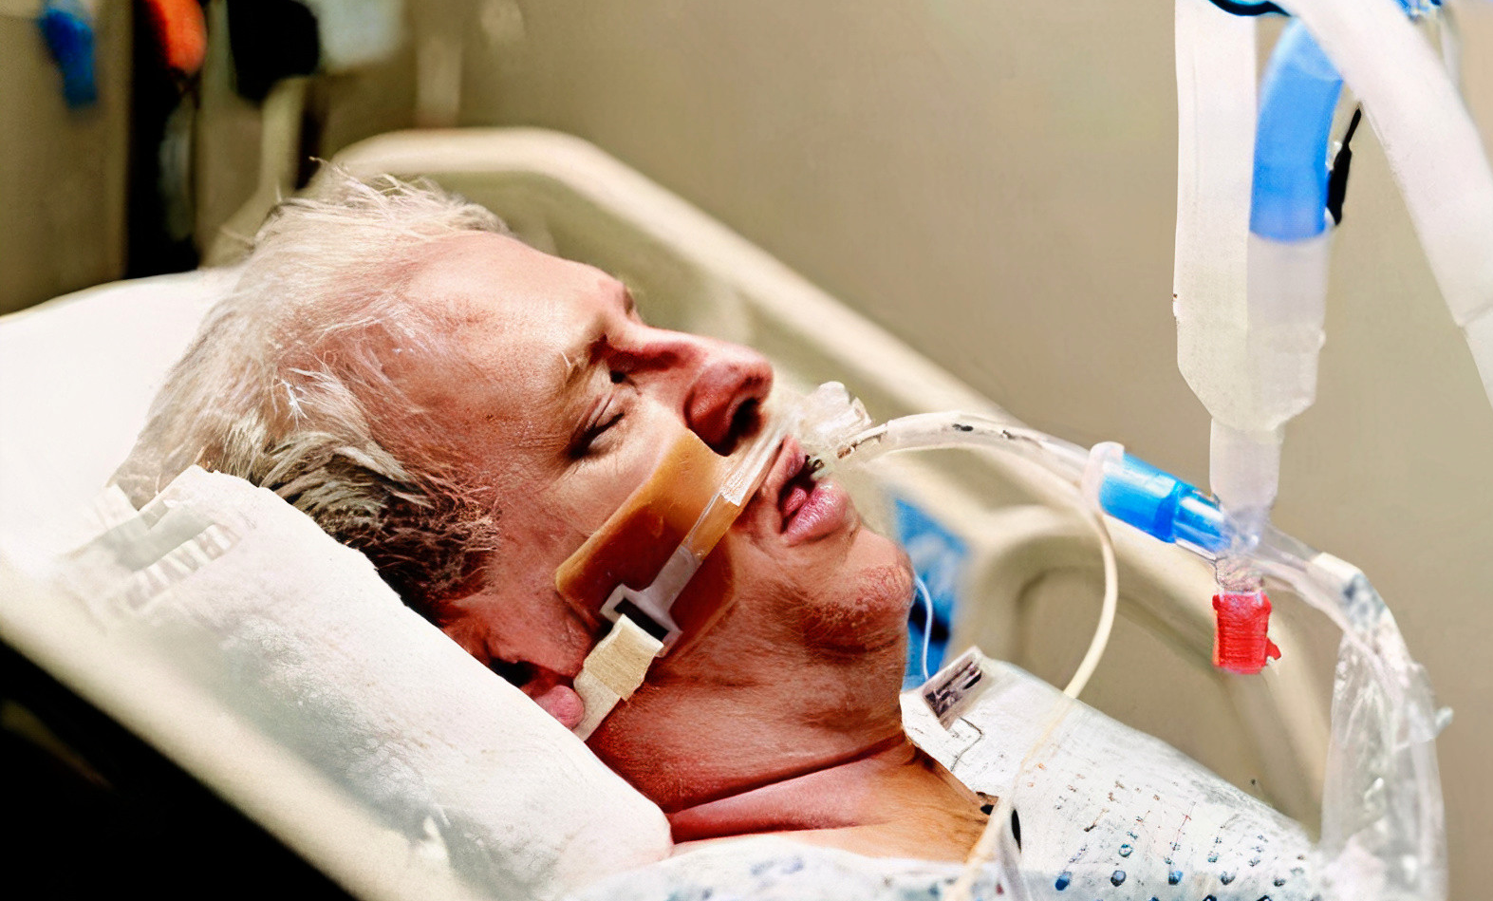
Microbial clinical cases
Dr.Dehbashi
Presented by: Mahdieh Hosseini Nezhad-Bahareh Tohidi- Negar Hamidfar- Mobina Esfandi- Nazanin Arefipour-Maryam Rouhbakhsh

Slide 2
Meningococcal meningitis
Ulcers caused by Bacillus cereus
Headache caused by Cryptococcus neoformans
Infection caused by Burkholderia mallei

Slide 3
Meningococcal meningitis

Slide 4
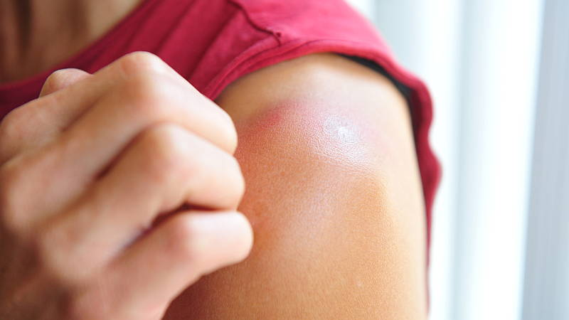
About the Patient
A 3-year-old girl, who was already healthy, went to the emergency room after 3 days of illness involving fever, headaches, lethargy and a sore body. Two purpuric lesions were observed in his left arm
Analysis the tests
1) Increase in white blood cells (12300 / µl)
46% neutrophil, 41% lymphocyte and 2% monocyte
2) Microscopic examination revealed a number of neutrophils containing intracellular cocoidal structures

Slide 5
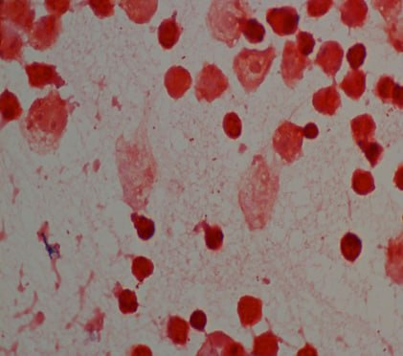
Gram staining CSF with the presence of gram negative diplococci

Slide 6
Ulcers caused by Bacillus cereus

Slide 7
About the Patient
Sampling and culture
A 33-year-old woman living in a rural area near Qom without any underlying disease came to our center with the main complaint of right wrist injury. According to this patient, the wound was caused by small vesicles, while he had no history of trauma such as cuts, scrapes, puncture wounds, bruises, etc.
The infected area was disinfected using 70% isopropyl alcohol and dried for 60 seconds.
To collect the sample, aspiration was performed using a needle from the edge and below the site of infection.
The sample was cultured on blood agar, chocolate agar and eosin methylene blue agar and incubated for 24 hours at 37°C.

Slide 8
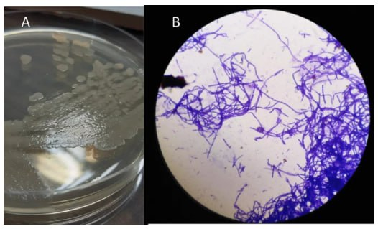
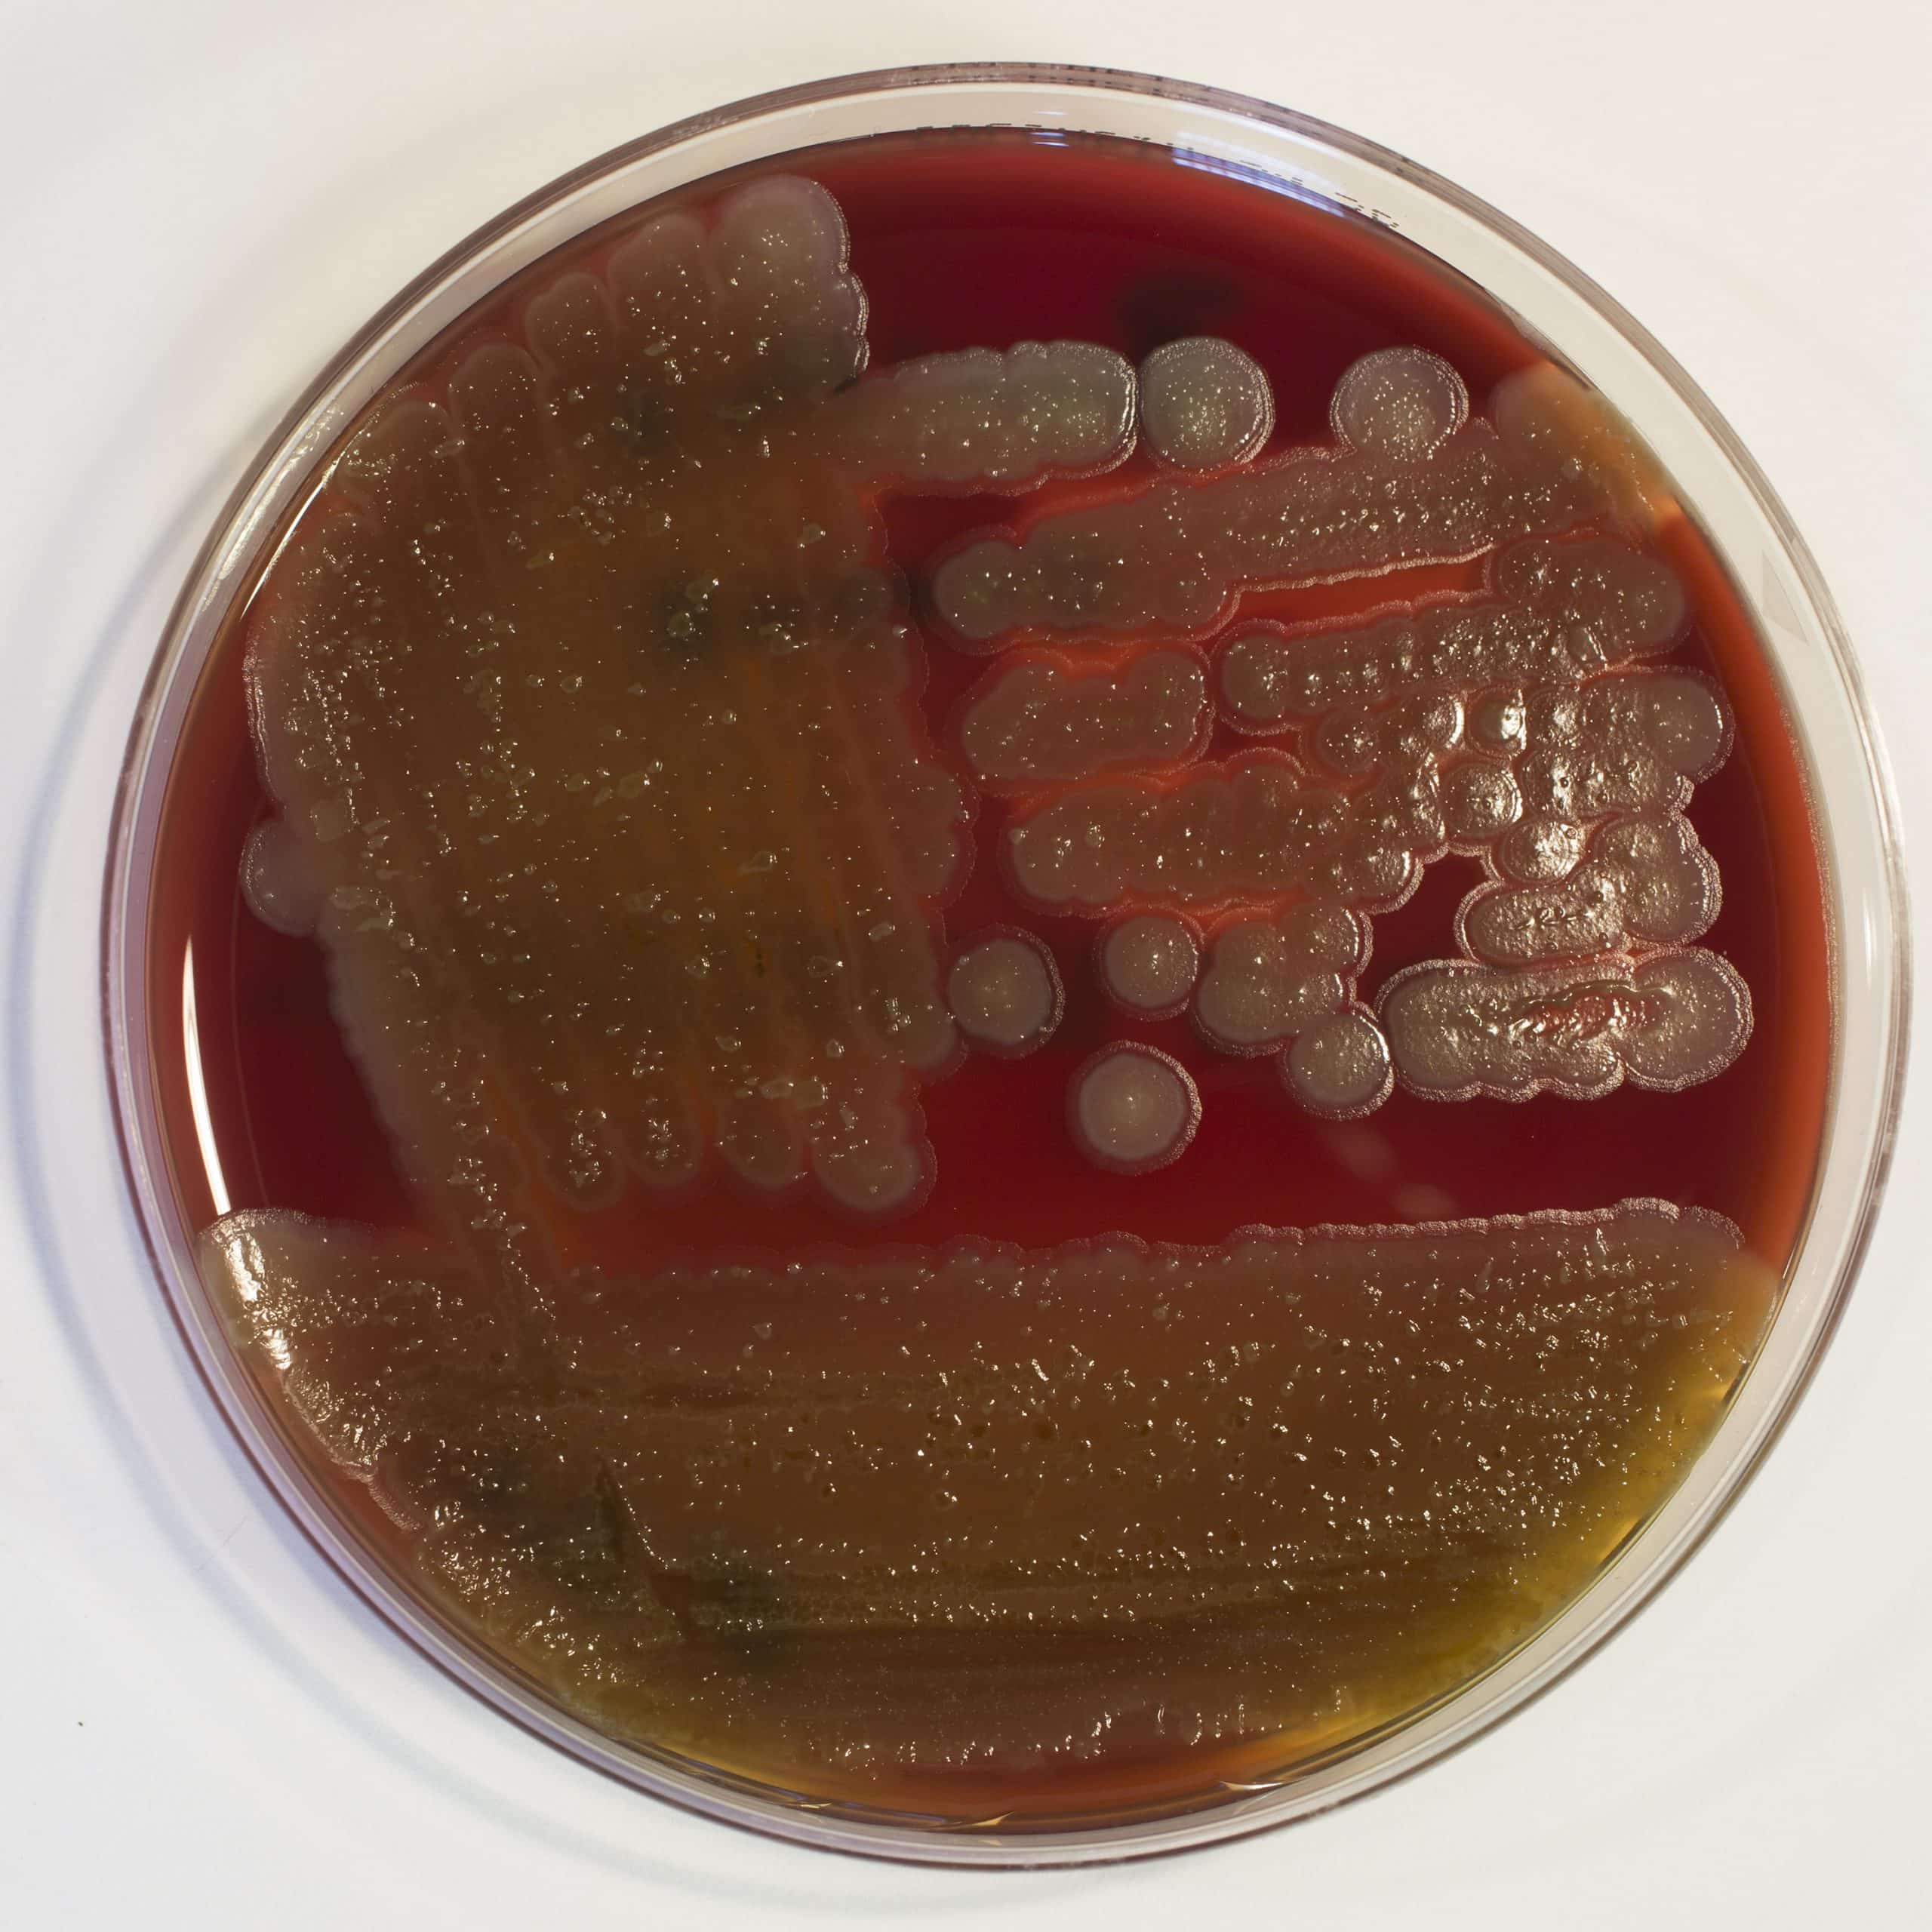
Analysis the tests
After incubation, pure colonies with non-pigmented, dry, round, smooth or slightly convex, opaque, milky and irregular edges were observed. In gram staining, a chain of large gram-positive bacilli was detected
In this study, we isolated Bacillus cereus from the skin lesion of the hand
The image of the wound published in this report has a completely different appearance, and the patient was not immunocompromised and did not have any underlying disease.
The strain was sensitive to gentamicin, ciprofloxacin, chloramphenicol and tetracycline. After consultation with two infectious disease specialists, treatment was performed with oral administration of ciprofloxacin (500 mg twice a day for 14 days). During the treatment, the patient's wound began to heal.
8

Slide 9
Headache caused by Cryptococcus neoformans

Slide 10
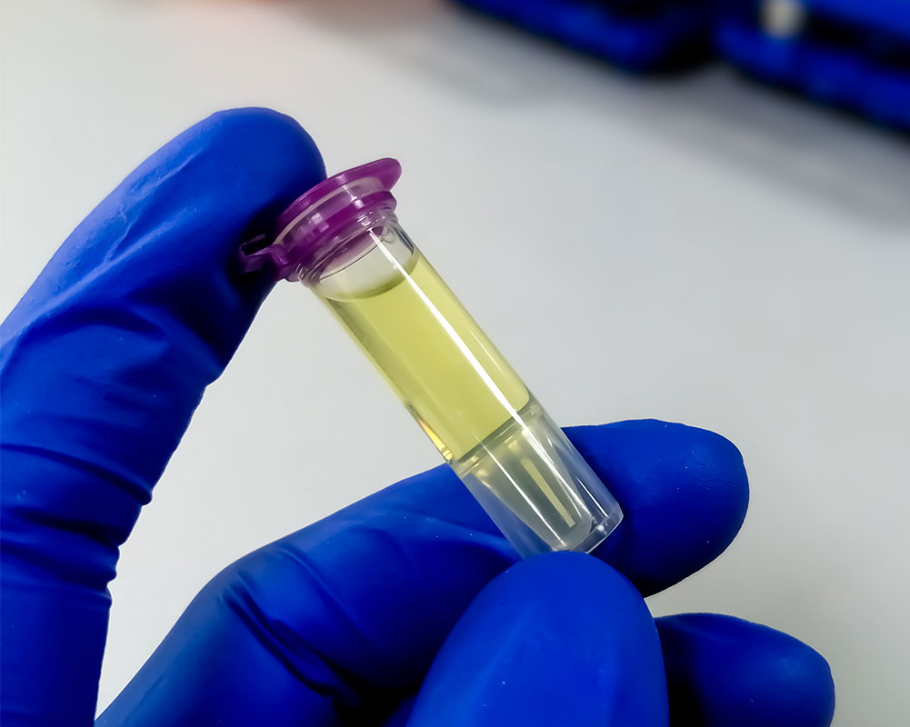
About the Patient
A 70-year-old man presented to the emergency department with a fever of 38.6°C (101.5°F).
He had a 6-month history of generalized daily headaches
neck stiffness,
retroorbital discomfort
night sweats,
and fever up to 37.8°C (100°F)
chronic lymphocytic leukemia (CLL)
Analysis (CSF) : 756 nucleated cells/mcL (91% lymphocytes)
decreased glucose (20 mg/dL)
increased protein (285 mg/dL).
White blood cells and yeast were detected in CSF

Slide 11
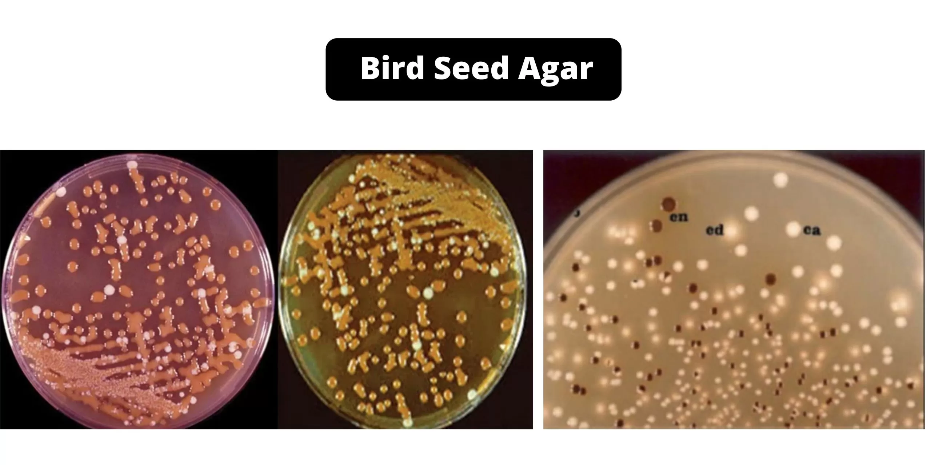
Tests
Cryptococcal antigen titer tests :
positive for CSF (more than 1:2,560) serum (1:160)
CSF fungal cultures grew Cryptococcus neoformans.

Slide 12
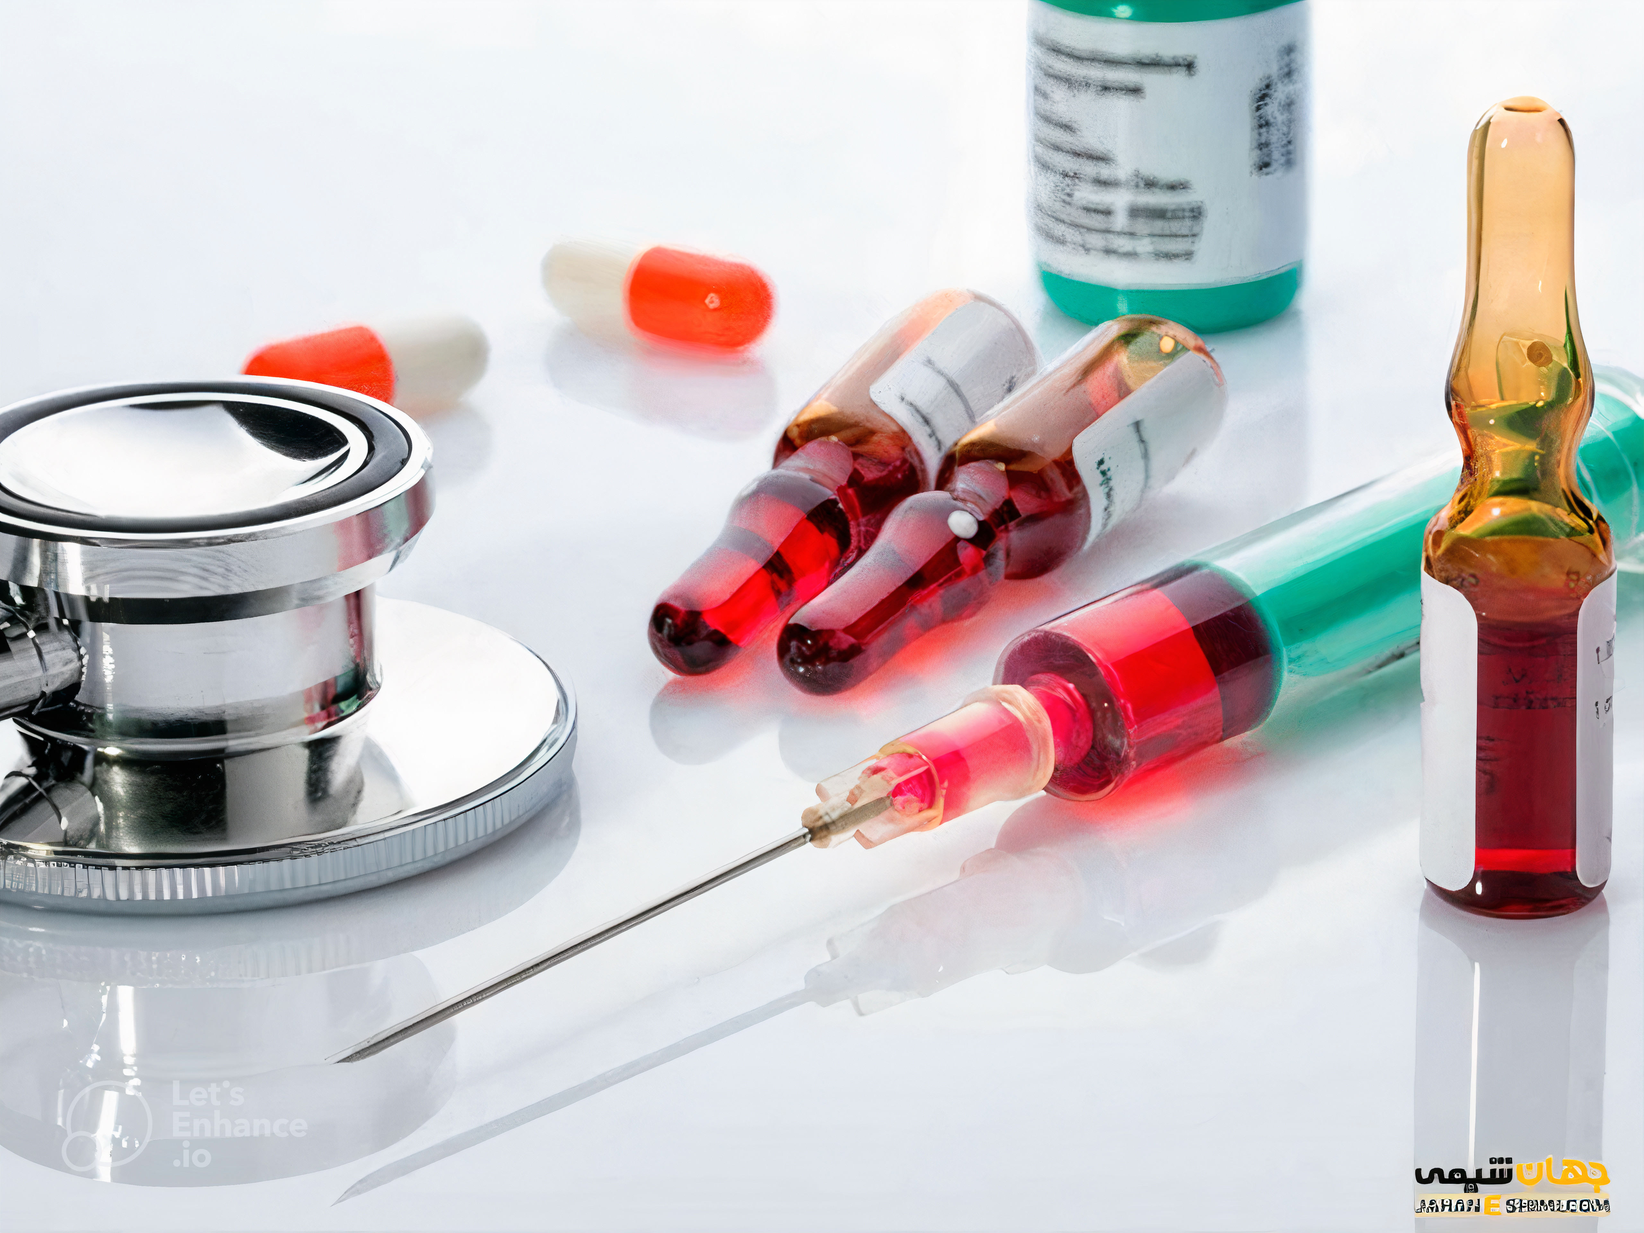
Treatment and follow up
Serum:
-Cr =2.2 mg/dl
-hypokalemia (K=3.4 mmol/L)
CSF:
-High protein (262 mg/dL)
-Glucose reduction (20 mg/dL)
-Smear and fungal culture were negative
broad-spectrum antibiotics
vancomycin meropenem
liposomal amphotericin B
discharged
stabilization phase
fluconazole (200 mg daily)
2 weeks after discharge
Start treatment
until the end of life
Cr =1.2 mg / dL
8 weeks of fluconazole (400 mg daily)
-Cr= 1.3 mg/dL
-K= 3.7 mmol/l

Slide 13
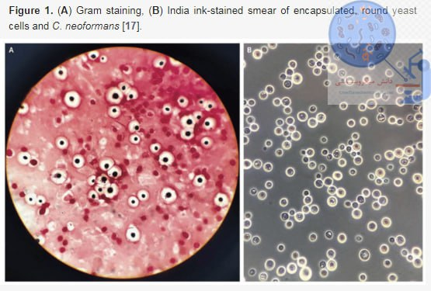
Cryptococcus neoformans
Cryptococcus neoformans is a facultative intracellular yeast found worldwide and often in bird feces. When inhaled, dried yeast cells or spores can cause a primary lung infection. The infection may remain latent but may become active when the host becomes immunocompromised. C neoformans then disseminates and crosses the blood-brain barrier, causing cryptococcal meningitis (CM).
Common symptoms include fever, weight loss, night sweats, headache, and altered mental status. This disease is seen in patients suffering from immunodeficiency with AIDS, organ transplantation, or blood malignancies. However, 10-40% of patients with cryptococcosis have no obvious immunodeficiency.
13

Slide 14
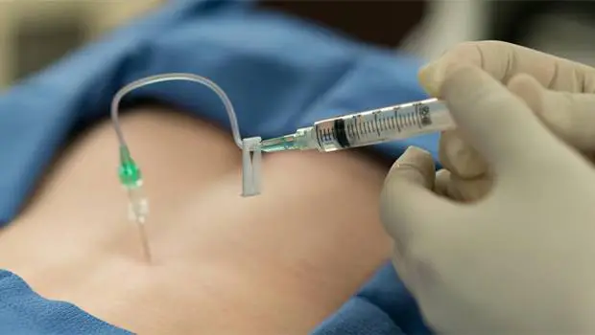
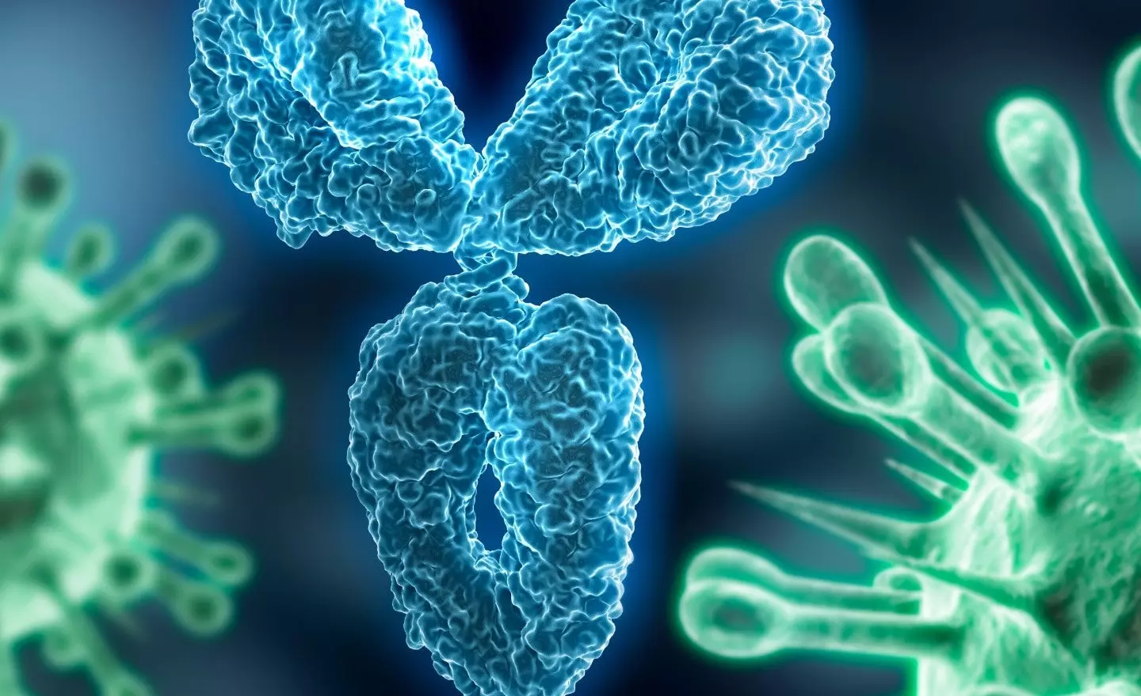
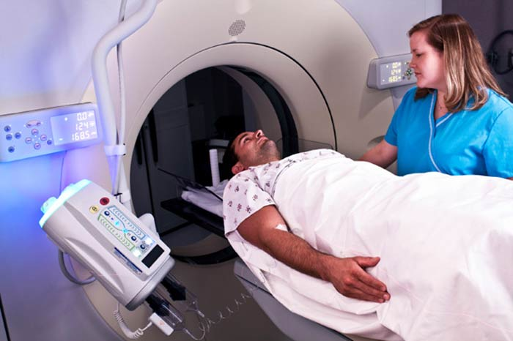
Diagnosis
treatment
To diagnose CM, a spinal fluid puncture is required.
Treatment regimens for patients can be different.
Increased protein
decreased glucose
increased white blood cell and lymphocytosis
HIV
Organ transplant
Use of immunosuppressive drugs
CSF antigen titers.
Amphotericin B deoxycholate
Nephrotoxicity
CT scan of the head.
Fluconazole
Meningeal enlargement,
nodule (cryptococcoma),
cerebral edema
hydrocephalus

Slide 15
Infection caused by Burkholderia mallei Glanders(مشمشه)

Slide 16
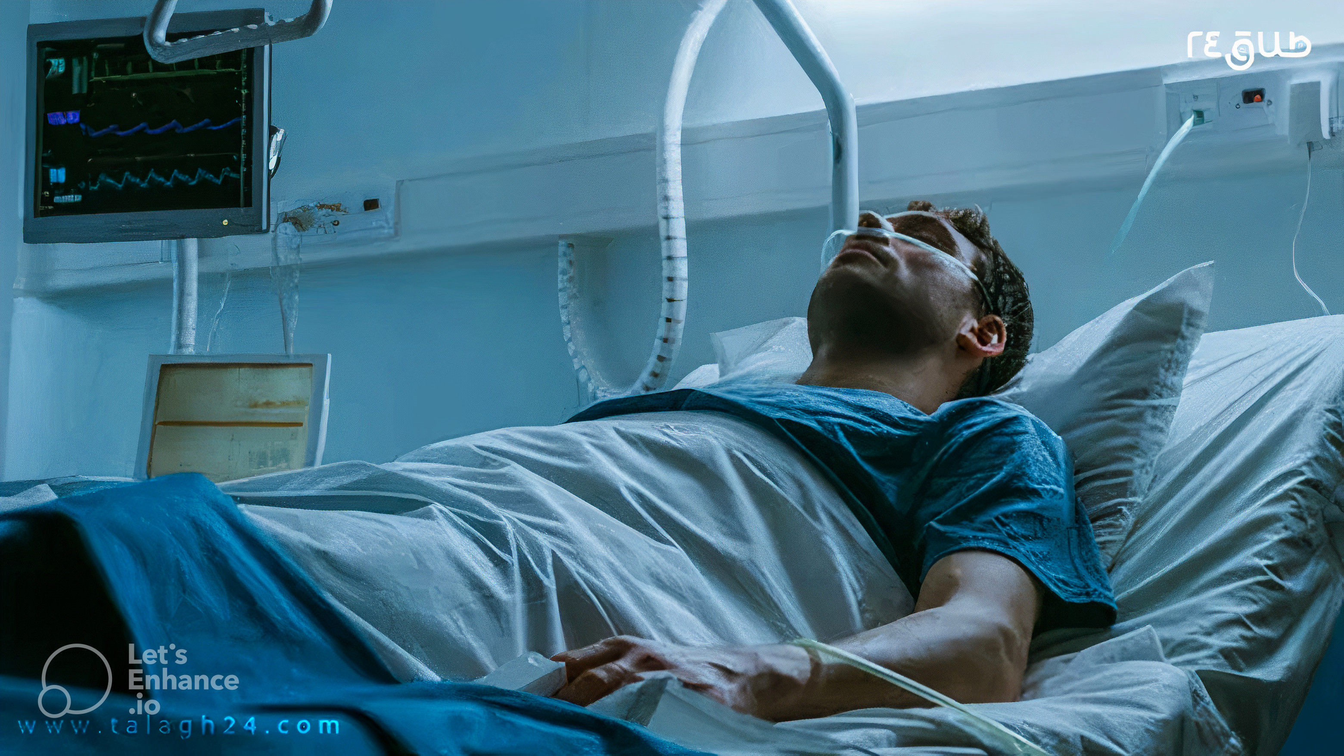
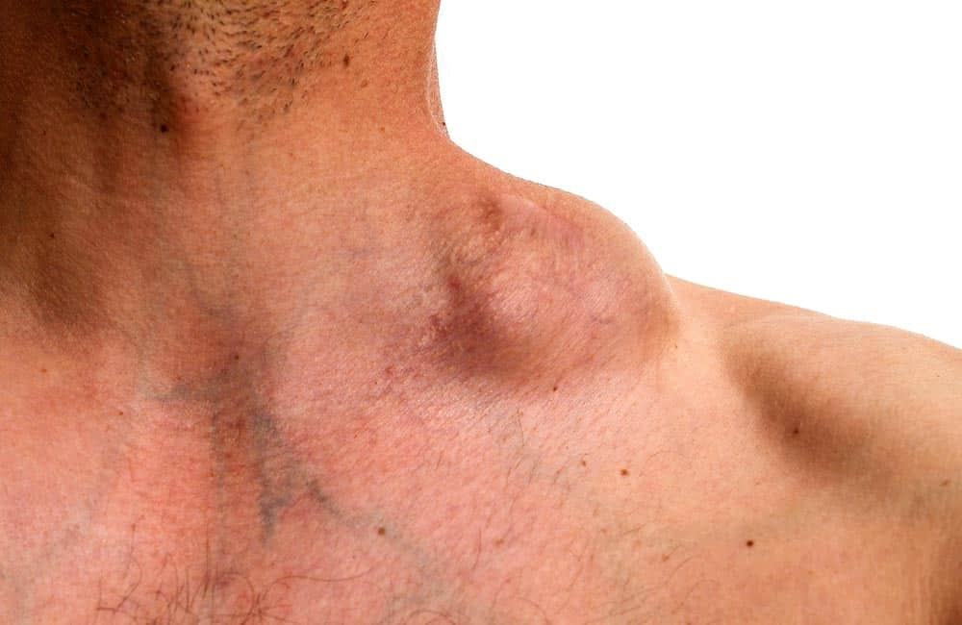
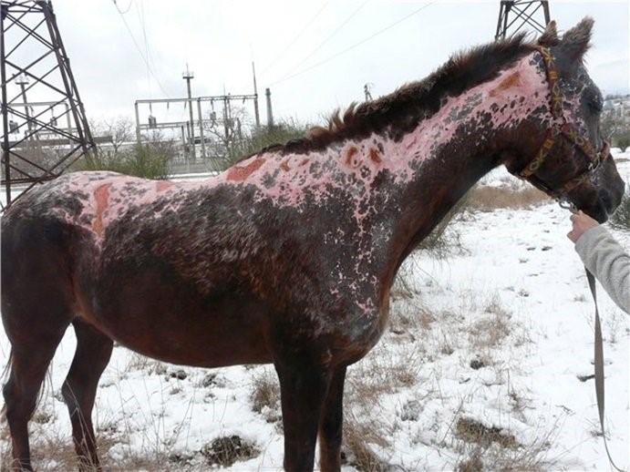
About the Patient
A 22-year-old man with no medical history came to the emergency department with symptoms.
The patient was admitted to the infectious department
A enlarged lymph nodein (5 mm)
1
2
Fever, chills, cough, runny nose, headache and diarrhea 5-6 times a day
3
Vomiting blood and melena
-The patient had just buried a dead horse that he claimed was ill.
- the patient's family had no symptoms.
The patient did not have any underlying disease and was not taking any medication.
4

Slide 17
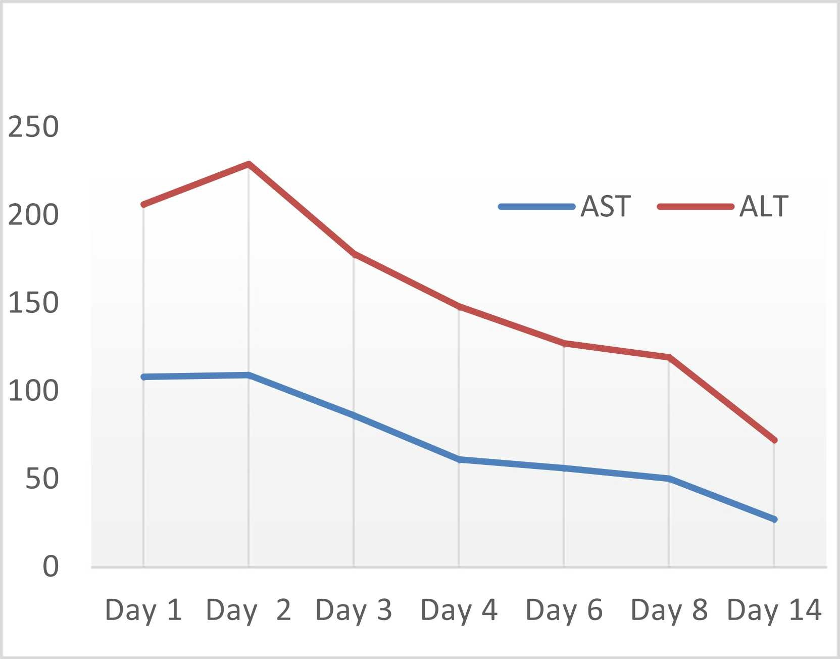
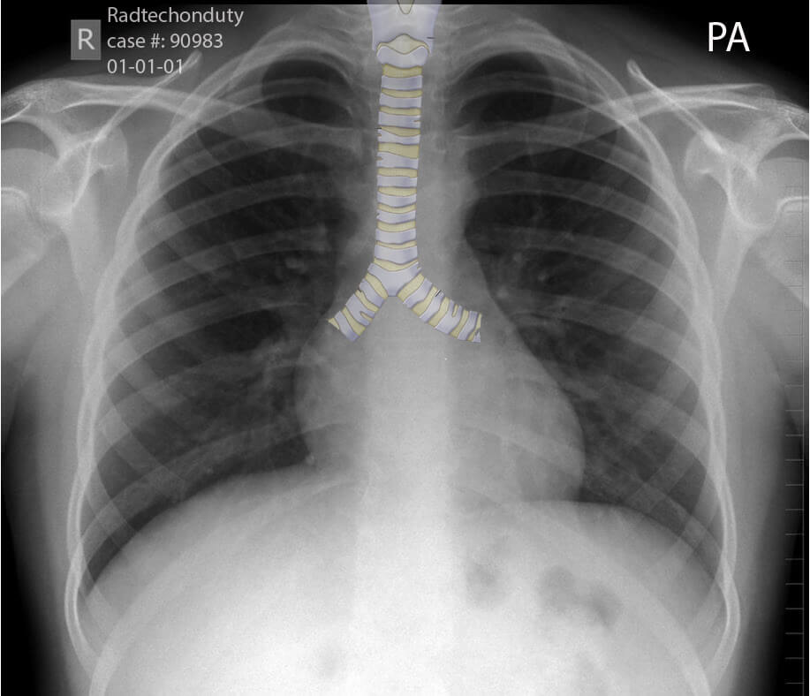
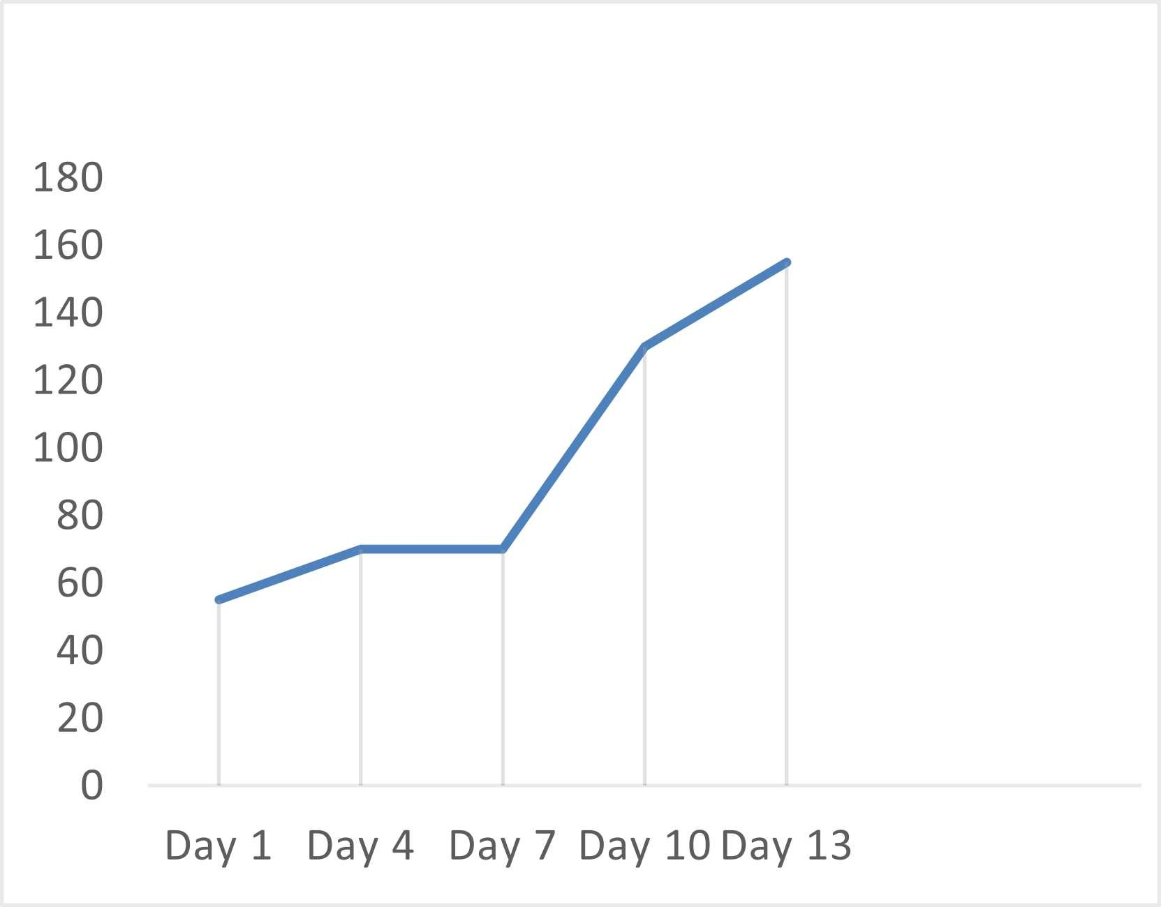
Analysis the tests
The chest X-ray and abdominal sonography did not show anything significant.
Stool exam normal
CBC
WBC | 3.9 × 109/L
platelet | 55 × 109/L
hemoglobin | 13.8 g/dL
Biochemistry
AST ALT | 108 U/L 98 U/L

Slide 18
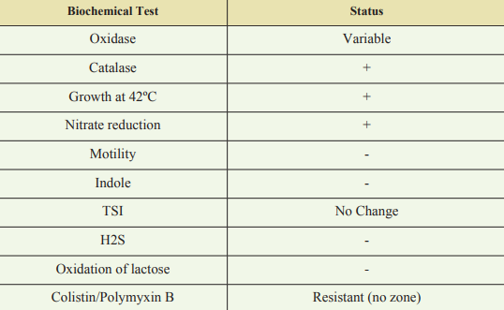
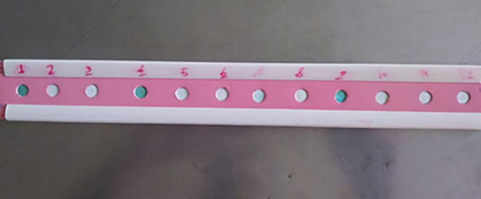
imipenem and doxycycline for one month
followed by oral azithromycin and doxycycline for six months.
Surgical treatment may be necessary for abscess formation in organs such as the prostate gland
No vaccine has been discovered for this
diagnosis
Treatment
Amplification and sequencing of specific BimA, IS407-flip and 23S rRNA genes
Culture
Serology :
CRP 56 mg/L
Spot staining test positive

Slide 19
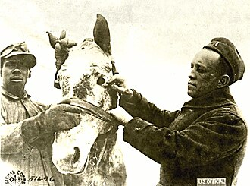
Glanders (مشمشه)
The lack of definite diagnostic symptoms and the rarity of this disease make it difficult to diagnose and one should be careful in dealing with its symptoms.
Also, paying attention to the patient's medical history and travel history to endemic areas can lead to timely diagnosis and treatment.
❛❛
Mild fever in the afternoon or night
Nausea
Pain
Headache
back pain
lymphadenopathy and chest pain are mentioned as the most common symptoms
Glandular disease is caused by the bacterium Burkholderia mallei and has been eradicated in many countries. but it may be difficult to diagnose due to its nonspecific symptoms.
This disease is very contagious. However, it is rare among humans, and the disease, which is very fatal if untreated, can be transmitted to humans through contact with infected animals, such as horses, donkeys, and mules.
Southeast Asia
If this disease is not treated, it can be fatal up to 95%
northern Australia

Slide 20
Resources
https://www.sciencedirect.com/science/article/pii/S2214250923001038?via%3Dihub
https://bmcinfectdis.biomedcentral.com/articles/10.1186/s12879-022-07372-9
https://citeseerx.ist.psu.edu/document?repid=rep1&type=pdf&doi=12744e03bda00a4a372ee98267b697939cdf27e1
20

Slide 21
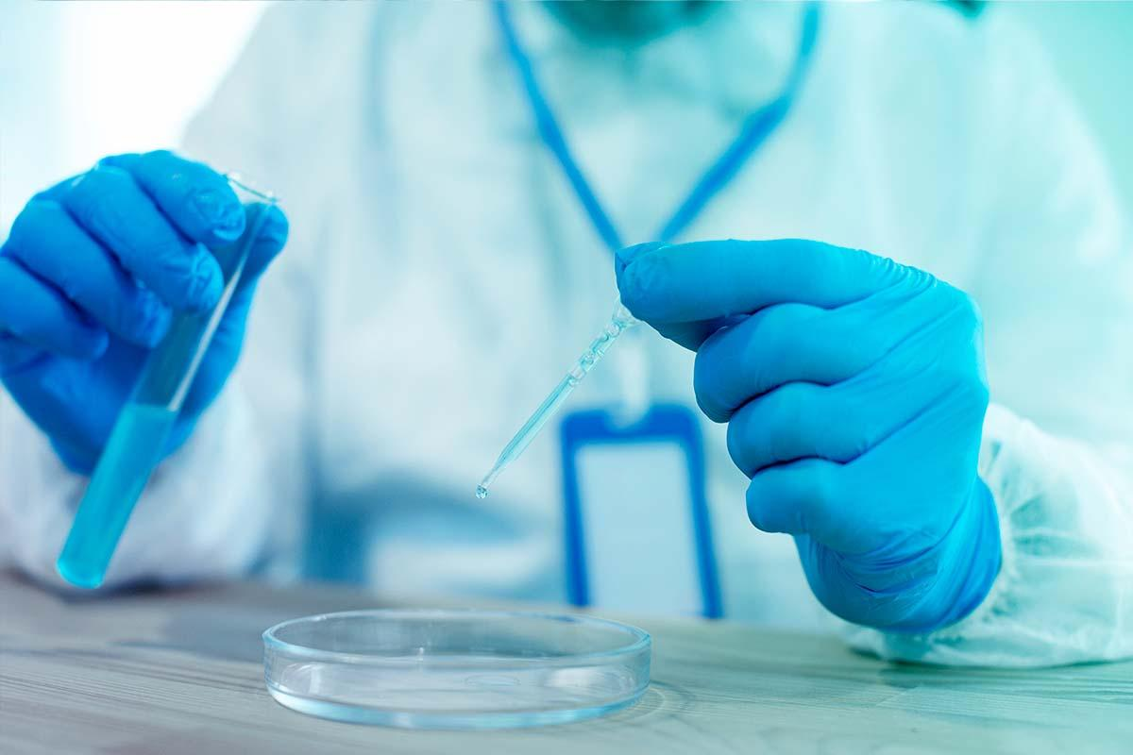
Th nks

